Slide 1
CS106X – Programming Abstractions in C++
CS2 in C++ Peer Instruction Materials by Cynthia Bailey Lee is licensed under a Creative Commons Attribution-NonCommercial-ShareAlike 4.0 International License. Permissions beyond the scope of this license may be available at http://peerinstruction4cs.org.
Cynthia Bailey Lee

Slide 2
Today’s Topics
Basic inheritance in C++
Some help with Stanford 1-2-3 Expression trees
Inheritance and the “virtual” keyword
Polymorphism

Slide 3
Inheritance in C++
The basics

Slide 4
class Circle { public: double myArea() { return 3.14159 * radius * radius; }
void setLoc(Loc center) { centerx = center.x; centery = center.y; }
Loc getLoc() { return Loc(centerx, centery); }
private:
double halfMoonArea() { return myArea / 2; }
int radius, centerx, centery; }; class FilledCircle : public Circle {
public: void setColor(std::string color) { this->color = color; }
std::string getColor() { return color; }
private:
std::string color; };
If we add a new public method “void doStuff()” to FilledCircle, which of the following lines of code would not be legal to include in doStuff()?
int topedge = centery – radius;
size_t colorstrlen = color.length();
double quarterarea = this->halfMoonArea()/4 + this->myArea()/8;
Other/none/more than one

Slide 5
Stanford 1-2-3 Walkthrough
The Expression class

Slide 6
Walkthrough of Stanford 1-2-3
Excel-like spreadsheet
Among other things, it needs to parse expressions
We did something similar to this earlier in the quarter (see next slide)

Slide 7
We can play the same game with non-alpha characters as keys: What does this print?
void traverse(Node *node) {
if (node != NULL) {
traverse(node->left);
traverse(node->right);
cout << node->key << " ";
}
}
* + / 3 4 8 2
* + 3 4 / 2
3 + 4 * 8 / 2
3 4 + 8 2 / *
Other/none/more
*
+
/
3
4
8
2

Slide 8
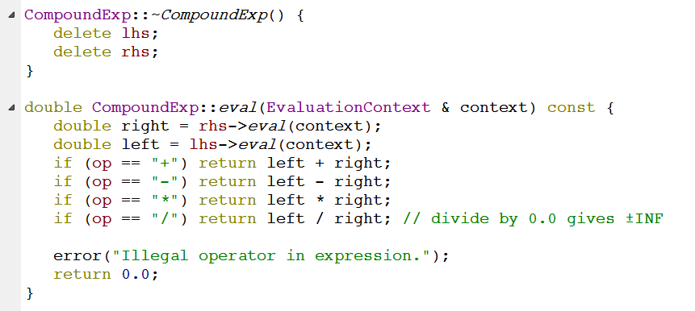
Evaluation of CompoundExp
This is in the implementation of CompoundExp—let’s take a look at the .h file to see what op, lhs, and rhs are

Slide 9
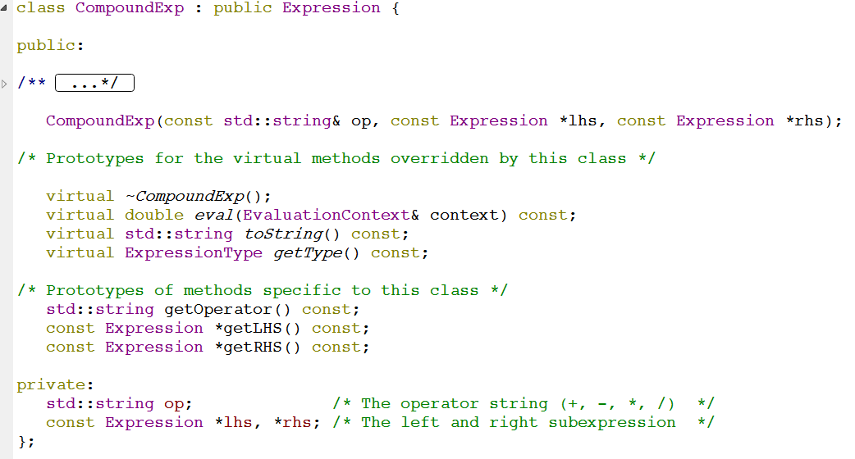
C++ and the “virtual” keyword

Slide 10
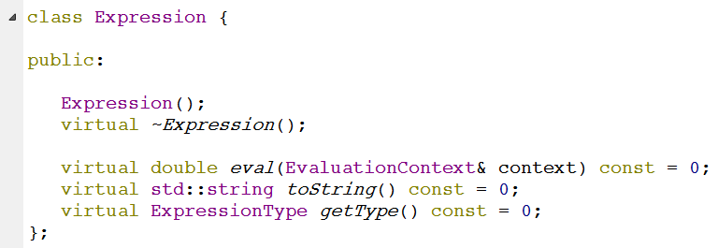
Expression (base class)
Note: you cannot actually create an Expression object
These methods are never implemented (note the “= 0”)
Expression exists solely to provide a base class to others
“pure virtual”

Slide 11
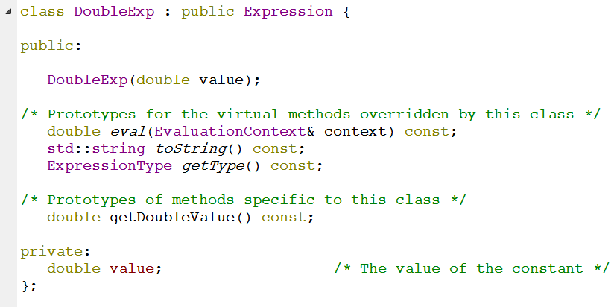
Another Derived class: DoubleExp

Slide 12
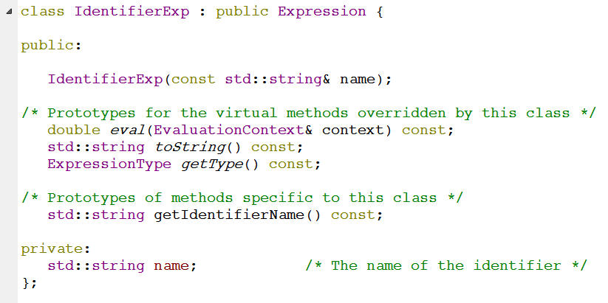
Another Derived class: IdentifierExp

Slide 13
Inheritance and the “is a” relationship
To write “class B is derived from class A”:
class B : public class A { … }
This means that:
An object of type B “is a” A
Any public methods of class A are inherited by class B, and become public methods of class B
Any private methods and data of class A are not accessible by class B
B may add some of its own public/private methods and data in the {} braces

Slide 14
class Square : public ________________ { public: virtual double myArea() { return side*side; }
private:
int length; }; class Rectangle : public ________________ {
public: virtual double myArea() { return length*width; }
private:
int length, width; };
class Shape {
public:
virtual double myArea() = 0; };
How should we fill in the blanks so that the class relationships match our understanding of geometry? (note: ignore ordering of declarations)
Square, Rectangle
Shape, Shape
Rectangle, Shape
Other/none/more than one

Slide 15
Stanford 1-2-3 eval
CompoundExp, DoubleExp, and IdentifierExp can all be lhs/rhs of CompoundExp, which is type Expression*
Because of the “is a” relationship
This diagram shows a CompoundExp object as the root of a tree, and the children are the LHS and RHS (private member variables of type Expressio*). LHS points to an object of type DoubleExp, with value 3.7. RHS points to an object of type IdentifierExp with name “foo”. Note that it is ok for the RHS and LHS pointers to point to DoubleExp and IdentifierExp objects, because these are derived classes of the base class Expression.

Slide 16
Stanford 1-2-3 eval
CompoundExp doesn’t want to care exactly what type its lhs and rhs are
Just calls eval() on whatever they are and gets the right value
This diagram shows a CompoundExp object as the root of a tree, and the children are the LHS and RHS (private member variables of type Expressio*). LHS points to an object of type DoubleExp, with value 3.7. RHS points to an object of type IdentifierExp with name “foo”. Note that it is ok for the RHS and LHS pointers to point to DoubleExp and IdentifierExp objects, because these are derived classes of the base class Expression.

Slide 17
class Mammal {
public:
virtual void makeSound() = 0; string toString() { return “Mammal”; } };
class Cat : public Mammal { public: string toString() { return “Cat”; } }; class Siamese : public Cat {
public:
virtual void makeSound() { cout << “meow” << endl; } };
How many of these compile? (A) 0-1 (B) 2-3 (C) 4 (D) I don’t know!
Siamese * s = new Siamese;
Mammal * m = new Cat;
Cat * c = new Siamese;
Siamese * s = new Cat;

Slide 18
Rules for “virtual”: pure virtual
If a method of a class looks like this:
virtual returntype method() = 0;
then this method is a called “pure virtual” function
and the class is called an “abstract class”
Abstract classes are like Java interfaces
You cannot do “= new Foo();” if Foo is abstract (just like Java interfaces)
ALSO, you cannot do “= new DerivedFoo();” if DerivedFoo extends Foo and DerivedFoo does not implement all the pure virtual methods of Foo

Slide 19
Rules for “virtual”: runtime calls
BaseType * obj = new DerivedType();
If we call a method like this: obj.method(), two different things could happen:
If method is not virtual, then BaseType’s implementation of method is called
If method is virtual, then DerivedType’s implementation of method is called
DerivedType * obj = new DerivedType();
If we call a method like this: obj.method(), only one thing could happen:
DerivedType’s implementation of method is called

Slide 20
class Mammal {
public:
virtual void makeSound() = 0; string toString() { return “Mammal”; } };
class Cat : public Mammal { public: virtual void makeSound() { cout << “rawr” << endl; }
string toString() { return “Cat”; } }; class Siamese : public Cat {
public:
virtual void makeSound() { cout << “meow” << endl; }
string toString() { return “Siamese”; } };
What is printed?
Siamese * s = new Siamese;
cout << s->toString();
“Mammal”
“Cat”
“Siamese”
Gives an error
Other/none/more

Slide 21
class Mammal {
public:
virtual void makeSound() = 0; string toString() { return “Mammal”; } };
class Cat : public Mammal { public: virtual void makeSound() { cout << “rawr” << endl; }
string toString() { return “Cat”; } }; class Siamese : public Cat {
public:
virtual void makeSound() { cout << “meow” << endl; }
string toString() { return “Siamese”; } };
What is printed?
Cat * c = new Siamese;
cout << c->toString();
“Mammal”
“Cat”
“Siamese”
Gives an error
Other/none/more

Slide 22
class Mammal {
public:
virtual void makeSound() = 0; string toString() { return “Mammal”; } };
class Cat : public Mammal { public: virtual void makeSound() { cout << “rawr” << endl; }
string toString() { return “Cat”; } }; class Siamese : public Cat {
public:
virtual void makeSound() { cout << “meow” << endl; }
string toString() { return “Siamese”; } };
What is printed?
Cat * c = new Siamese;
c->makeSound();
“rawr”
“meow”
“Siamese”
Gives an error
Other/none/more

Slide 23
How does this relate to Stanford 1-2-3?
eval() must be virtual, or we wouldn’t call the eval() implementations specific to the derived classes like DoubleExp and IdentifierExp
This diagram shows a CompoundExp object as the root of a tree, and the children are the LHS and RHS (private member variables of type Expressio*). LHS points to an object of type DoubleExp, with value 3.7. RHS points to an object of type IdentifierExp with name “foo”. Note that it is ok for the RHS and LHS pointers to point to DoubleExp and IdentifierExp objects, because these are derived classes of the base class Expression.

Slide 24
Which best explains good design of destructors in polymorphic classes?
Destructors are specific to each class, so we don’t need to apply virtual to them
Destructors should be virtual or we will cause a memory leak in cases like this: “DerivedType obj = new DerivedType(); delete obj;”
Destructors should be virtual or we will cause a memory leak in cases like this: “BaseType obj = new DerivedType(); delete obj;”
Both B and C
Other/none

