Slide 1
CS106X – Programming Abstractions in C++
CS2 in C++ Peer Instruction Materials by Cynthia Bailey Lee is licensed under a Creative Commons Attribution-NonCommercial-ShareAlike 4.0 International License. Permissions beyond the scope of this license may be available at http://peerinstruction4cs.org.
Cynthia Bailey Lee

Slide 2
Today’s Topics: Pointers!
Pointers and memory addresses
Dynamic memory allocation (new/delete)

Slide 3
Examples of the & operator
int x = 42;
int y;
int a[3] = {91, -3, 85};
double d = 3.0;
cout << x << endl; // 42
cout << &x << endl; // 0x7f8e20
cout << y << endl; // 17
cout << &y << endl;
cout << a << endl; // 0x7f8e24
cout << &a[0] << endl; // 0x7f8e28
cout << &a[1] << endl; // 0x7f8e2c
cout << &a[2] << endl;
cout << &d << endl; // 0x7f8e30
Stack
0x28F630
0x28F62c
0x28F628
0x28F624
0x28F620
0x28F61c
0x28F618
Heap
0
Notes:
Paste this code into QTCreator!
Things to notice about this example:
y’s address is less than x’s address (at least on my laptop), because QT’s compiler likes to allocated stack frame space in order and notice that as the stack grows, it grows DOWN towards memory address zero.
What prints out when we print y could be anything! y was allocated space on the stack but was never initialized. Whatever happened to be left over from whoever used that space last is what we will find there. (Note that the Stanford library Vector<int> Grid<int> etc will initialize the int’s to 0 for you. THIS IS NOT NORMAL IN C++ and is a feature of the Stanford library ADTs.)
Arrays in C++ are just a pointer to the first element of the array. So “cout << a” gives the same thing as “cout << &(a[0])”. IMPORTANT CONSEQUENCE OF THIS IS THAT C++ ALLOWS YOU TO WRITE PAST THE END OF AN ARRAY, because arrays don’t “know” how long they are, they only know where they start! So you could do a[500] = 22; and write 22 to some who-knows-where place in memory and really mess up your program.
Variables of type double are allocated more space than variables of type int. You can see the “gap” between memory addresses is bigger between double and the next variable’s address than would be for int.

Slide 4
Examples of the & operator
Each memory address indexes one byte (8 bits). Can you deduce from the drawing at right how many bits are used to represent int and double, respectively?
4bits, 8bits
16bits, 16bits
16bits, 32bits
32bits, 64bits
Other/none/more
Stack
0x28F630
0x28F62c
0x28F628
0x28F624
0x28F620
0x28F61c
0x28F618
int
int
int
int
int
double
Heap
0
Notes:
Paste this code into QTCreator!
Things to notice about this example:
y’s address is less than x’s address (at least on my laptop), because QT’s compiler likes to allocated stack frame space in order and notice that as the stack grows, it grows DOWN towards memory address zero.
What prints out when we print y could be anything! y was allocated space on the stack but was never initialized. Whatever happened to be left over from whoever used that space last is what we will find there. (Note that the Stanford library Vector<int> Grid<int> etc will initialize the int’s to 0 for you. THIS IS NOT NORMAL IN C++ and is a feature of the Stanford library ADTs.)
Arrays in C++ are just a pointer to the first element of the array. So “cout << a” gives the same thing as “cout << &(a[0])”. IMPORTANT CONSEQUENCE OF THIS IS THAT C++ ALLOWS YOU TO WRITE PAST THE END OF AN ARRAY, because arrays don’t “know” how long they are, they only know where they start! So you could do a[500] = 22; and write 22 to some who-knows-where place in memory and really mess up your program.
Variables of type double are allocated more space than variables of type int. You can see the “gap” between memory addresses is bigger between double and the next variable’s address than would be for int.

Slide 5
Pointers!
int x = 42;
int* p = &x; // pronounced “pointer to int”
cout << p << endl; // 0x7f8e20
cout << *p << endl; // 42
*p = x*x;
cout << x << endl;
int a[3] = {5,6,0};
p = a;
cout << p[1] << endl;
Pointer stores the address of a variable
* operator gets/sets the value stored at a memory address of that pointer
NOTICE:
3 distinct meanings of * in C++!

Slide 6
Why do you think C++ makes you declare p as type int* (“pointer to int”) rather than just * (“pointer”)?
Think like a language designer:
Who knows. There’s a lot about C++ that’s just inexplicable/weird/relic of ye olde tymes.
int* and double* occupy different amounts of memory. We need to know how much space to allocate for a given pointer variable in the stack frame
Other/none/more than one
int x = 42;
int* p = &x;
cout << p << endl; // 0x7f8e20
cout << *p << endl; // 42
*p = x*x;
cout << x << endl;
int a[3] = {5,6,0};
p = a;
cout << p[1]<< endl;
(assuming machine with 32-bit int and 64-bit double)

Slide 7
Pointer arithmetic
Operators +, -, ++, -- work on pointers
Incrementing a T* (pointer to type T) by 1 moves forward by sizeof(T) in memory
You can use [k] syntax to access memory k slots away from p (equivalent to +k)
(Corollary: An array variable is really just a pointer to the array's first element.)
int a[4] = {91, -2, 85, 17};
int* p = a; // p = &a[0];
p[1] = 5; // a[1] = 5;
p++; // p = &a[1];
cout << *p << endl; // 5
*(p + 2) = 26; // a[3] = 26;
cout << p[2] << endl;
cout << a[2] << endl;
What prints here?
26, 26
26, [other]
[other], 26
[other], [other]

Slide 8
Software engineering tip: If not initializing a pointer right away, use NULL to force your program to crash (really!) if you try to use the pointer
Common error:
Prevention:
int* foo;
…
*foo = 555;
int* foo = NULL;
…
*foo = 555;

Slide 9
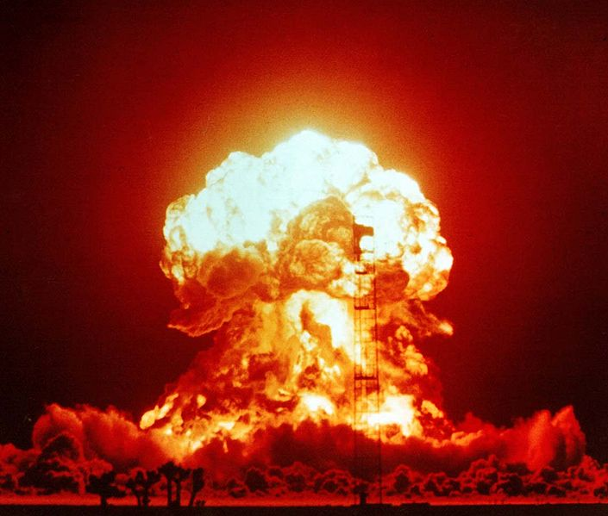
Software engineering tip: If not initializing a pointer right away, use NULL to force your program to crash (really!) if you try to use the pointer
Common error:
Prevention:
int* foo;
…
*foo = 555;
int* foo = NULL;
…
*foo = 555;
Stack
0x28F620
Heap
Image is in the public domain: http://en.wikipedia.org/wiki/File:Operation_Upshot-Knothole_-_Badger_001.jpg

Slide 10
Dynamic memory allocation
Potentially getting yourself in a heap of trouble!
(haha)

Slide 11
The stack, scope, and the lifespan of memory
main()
mymethod() x:
xfac:
10
0
factorial() n:
10
void foo() {
Lexicon english(“EnglishWords.dat”);
for (string word : english) {
cout << word << endl;
}
} // at this point stack frame is
// popped and english disappears
// forever
What if we want english to persist?
We could return it—does that make this particular english persist? No, makes a copy
Why can’t it make this particular english persist?
Why might copying be undesirable?
factorial() n:
9
Heap

Slide 12
new and delete
new asks for an allocation of memory on the heap
Heap doesn’t pop! Can stay there as long as we want!
Er…so when does it go away then?
There is no automatic time, so we have to be careful to manually let it go when we are done
delete

Slide 13
Dynamic memory allocation
What does this print?
0x12, 5
0x4, 7
0x12, 7
0x4, 5
Other/none/ more
int * p1 = new int;//0x12
*p1 = 5;
int * p2 = new int;//0x4
*p2 = 7;
int * p3 = new int;//0x20
*p3 = 8675309; // important phone #
*p1 = *p2;
cout << p1 << “ “ << *p1 << endl;
p1 = p2;
p1 = p3;
delete p1;
delete p2;
// don’t delete p3 because we need that
cout << *p3 << endl;

Slide 14
Dynamic memory allocation
int * p1 = new int;//0x12
*p1 = 5;
int * p2 = new int;//0x4
*p2 = 7;
int * p3 = new int;//0x20
*p3 = 8675309; // important phone #
*p1 = *p2;
cout << p1 << “ “ << *p1 << endl;
p1 = p2;
cout << p1 << “ “ << *p1 << endl;
delete p1;
delete p2;
// don’t delete p3 because we need that
cout << *p3 << endl;
What does this print?
0x12, 5
0x4, 7
0x12, 7
0x4, 5
Other/none/more

Slide 15
Dynamic memory allocation
These last three lines…
Looks good!
Didn’t do enough deleting
Did too much deleting
Accessed memory after deleting
Other/none/more
int * p1 = new int;//0x12
*p1 = 5;
int * p2 = new int;//0x4
*p2 = 7;
int * p3 = new int;//0x20
*p3 = 8675309; // important phone #
*p1 = *p2;
cout << p1 << “ “ << *p1 << endl;
p1 = p2;
cout << p1 << “ “ << *p1 << endl;
delete p1;
delete p2;
cout << *p3 << endl; //print important phone #

Slide 16
(again) Use NULL to ensure your program crashes (really!)
Common error:
Prevention:
delete foo;
…
*foo = 555;
delete foo;
foo = NULL;
…
*foo = 555;
Stack
0x28F620
Heap
Image is in the public domain: http://en.wikipedia.org/wiki/File:Operation_Upshot-Knothole_-_Badger_001.jpg

