Slide 1
CS106X – Programming Abstractions in C++
CS2 in C++ Peer Instruction Materials by Cynthia Bailey Lee is licensed under a Creative Commons Attribution-NonCommercial-ShareAlike 4.0 International License. Permissions beyond the scope of this license may be available at http://peerinstruction4cs.org.
Cynthia Bailey Lee

Slide 2
Today’s Topics: Recursion!
Backtracking recursion technique
Periodic Table Speller
Fibonacci
Is recursion good or bad for performance?

Slide 3
Backtracking
Periodic table speller

Slide 4
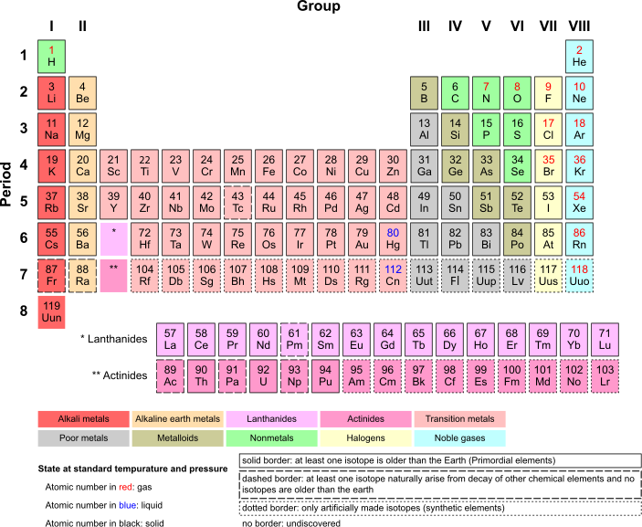
http://commons.wikimedia.org/wiki/File:Periodic_Table_Armtuk3.svg
This file is licensed under the Creative Commons Attribution-Share Alike 3.0 Unported license.

Slide 5
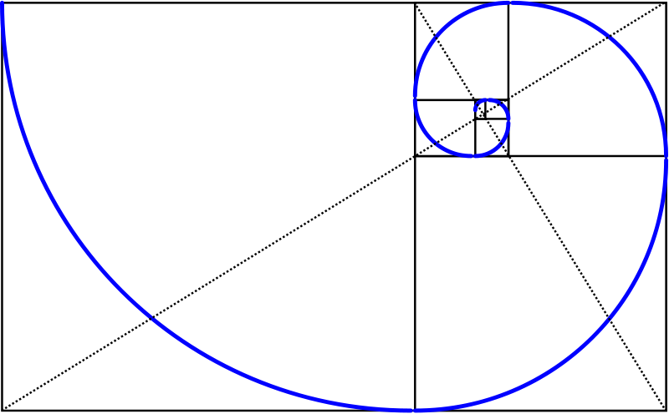
Fibonacci
This image is licensed under the Creative Commons Attribution-Share Alike 3.0 Unported license. http://commons.wikimedia.org/wiki/File:Golden_spiral_in_rectangles.png

Slide 6
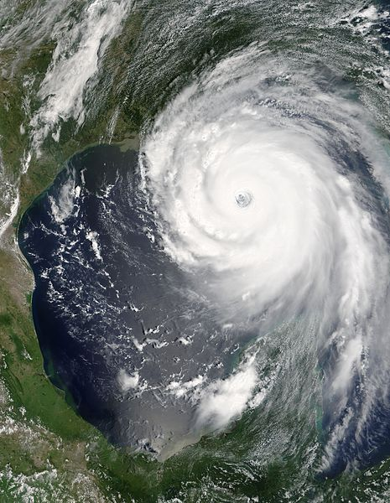
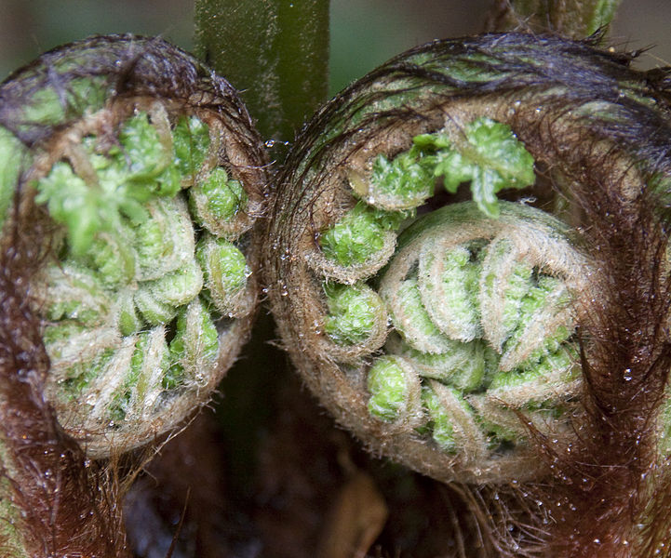
Fibonacci
f(0) = 0
f(1) = 1
For all n > 1:
f(n) = f(n-1) + f(n-2)
These files are, respectively: public domain (hurricane) and licensed under the Creative Commons Attribution 2.0 Generic license (fibonacci and fern.

Slide 7
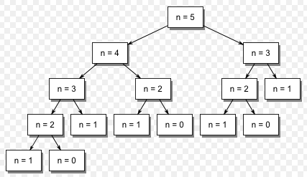
Fibonacci
F(0) = 0
F(1) = 1
F(n) = F(n-1) + F(n-2) for all n > 1
Work is duplicated throughout the call tree
F(2) is calculated 3 separate times when calculating F(5)!
15 function calls in total for F(5)!
Image is in the public domain. http://commons.wikimedia.org/wiki/File:Fibonacci_call_tree_5.gif

Slide 8
Fibonacci
F(2) is calculated 3 separate times when calculating F(5)!
How many times would we calculate Fib(2) while calculating Fib(6)? See if you can just “read” it off the chart above.
4 times
5 times
6 times
Other/none/more
Image is in the public domain. http://commons.wikimedia.org/wiki/File:Fibonacci_call_tree_5.gif

Slide 9
Fibonacci
N | fib(N) | # of calls to fib(2)
2 | 1 | 1
3 | 2 | 1
4 | 3 | 2
5 | 5 | 3
6 | 8
7 | 13
8 | 21
9 | 34
10 | 55
Image is in the public domain. http://commons.wikimedia.org/wiki/File:Fibonacci_call_tree_5.gif

Slide 10
Efficiency of naïve Fibonacci implementation
When we added 1 to the input to Fibonacci, the number of times we had to calculate a given subroutine nearly doubled (~1.6 times*)
Ouch!
Can we predict how much time it will take to compute for arbitrary input n?
* This number is called the “Golden Ratio” in math—cool!

Slide 11
Efficiency of naïve Fibonacci implementation
Can we predict how much time it will take to compute for arbitrary input n?
Each time we add 1 to the input, the time increases by a factor of 1.6
For input n, we multiply the “baseline” time by 1.6 n times:

Slide 12
Efficiency of naïve Fibonacci implementation
Can we predict how much time it will take to compute for arbitrary input n?
Each time we add 1 to the input, the time increases by a factor of 1.6
For input n, we multiply the “baseline” time by 1.6 n times:
b * 1.6 * 1.6 * 1.6 * … * 1.6
n times

Slide 13
Efficiency of naïve Fibonacci implementation
Can we predict how much time it will take to compute for arbitrary input n?
Each time we add 1 to the input, the time increases by a factor of 1.6
For input n, we multiply the “baseline” time by 1.6 n times:
b * 1.6 * 1.6 * 1.6 * … * 1.6 = b * 1.6^{n}
n times

Slide 14
Efficiency of naïve Fibonacci implementation
Can we predict how much time it will take to compute for arbitrary input n?
Each time we add 1 to the input, the time increases by a factor of 1.6
For input n, we multiply the “baseline” time by 1.6 n times:
b * 1.6 * 1.6 * 1.6 * … * 1.6 = b * 1.6^{n}
We don’t really care what b is exactly (different on every machine anyway), so we just normalize by saying b = 1 “time unit” (i.e. we remove b)
= “exponential”
category
n times

Slide 15
Aside: recursion isn’t always this bad
Memory
Recursive code
main()
long factorial ( int n ) {
cout << n << endl;
if (n==1) return 1;
return n*factorial(n–1);
}
“Roughly” how much time does factorial take, as a function of the input n?
It’s better, just b * n = n
mymethod() x:
xfac:
10
0
factorial() n:
10
Heap
0

Slide 16
Fibonacci
Assume we have to calculate each unique function call once, but never again
We “remember” the answer from the first time
How many rectangles remain in the above chart for n=5?
3
5
7
9
Other/none/more than one
Image is in the public domain. http://commons.wikimedia.org/wiki/File:Fibonacci_call_tree_5.gif

Slide 17
For some integer n>2, what is the largest number of function calls that can be triggered by the calculation of F(n) in this new “remember” system?
New rule:
Assume we have to calculate each unique function call once, but never again
We “remember” the answer from the first time
Approx. log(n)
Approx. n
Approx. n²
Approx. 2^{n}
Other/none/more

Slide 18
Memo-ization
Take notes (“memos”) as you go
For Fibonacci, we will have answers for F(i) for all i 0 <= i <= n, so a simple array or Vector can store intermediate results:
results[i] stores Fib(i)
Map could also be a good choice:
results[obj] stores RecursiveFunction(obj)
For functions with two integer inputs a,b, you can keep memos in a Grid:
results[a][b] stores RecursiveFunction(a,b)

