Slide 1
CSE 105 Theory of Computation
Alexander Tsiatas
Spring 2012
Theory of Computation Lecture Slides by Alexander Tsiatas is licensed under a Creative Commons Attribution-NonCommercial-ShareAlike 3.0 Unported License.
Based on a work at http://peerinstruction4cs.org.
Permissions beyond the scope of this license may be available at http://peerinstruction4cs.org.

Slide 2
Co-Turing-Recognizable Languages
Our current classes of langauges:
Regular
Context-free
Decidable
Recognizable
Co-recognizable
We now have the new class “co-recognizable”
Language A is co-recognizable if the complement of A is recognizable
Co-recognizable does NOT mean “a language that is not recognizable”

Slide 3
Para, Para, paradox…
Preparing for DIAGONALIZATION!

Slide 4
Warm-up
All regular languages are decidable.
There is a number 5 written above this sentence.
TRUE
FALSE
Not enough information to decide between (a) and (b)
Other
TRUE
FALSE
Not enough information to decide between (a) and (b)
Other

Slide 5
This sentence is false.
TRUE
FALSE
Not enough information to decide between (a) and (b)
Other

Slide 6
Liar’s Paradox
“This sentence is false.”
This has been perplexing people since at least the Greeks in 4th century BCE (2300 years!)
What are some key features of this that make it a paradox?

Slide 7
Two more examples
This sentence is 10 characters long.
This sentence is in French.
TRUE
FALSE
Not enough information to decide between (a) and (b)
Other
TRUE
FALSE
Not enough info
Other

Slide 8
Barber’s Paradox i.e., Russell’s Paradox
A certain town has only one barber (a man). All the men in the town are clean-shaven. For all men m in the town, the barber shaves m if and only if m does not shave himself.
Question: Does the barber shave himself?
YES
NO
Not enough information to decide between (a) and (b)
Other

Slide 9
Making Lists
Suppose you have many, many lists.
So many, in fact, that some of your lists are lists of lists (to help you organize your lists), and some of them even include themselves.
Ex: “list of lists I have created today.”

Slide 10
List Organization Question
You are aware that self-reference can cause problems, and you want to be careful of the lists of lists that include themselves.
So you make a list of all lists that do not include themselves, called NON-DANGER-LIST.
Question:
Should NON-DANGER-LIST include itself?
YES
NO
Not enough information to decide between (a) and (b)
Other

Slide 11
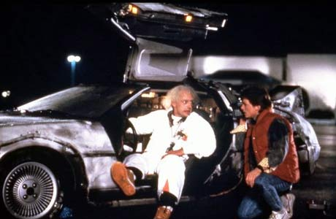
Grandparent Paradox (Time Travel Paradox)
You travel back in time and prevent one pair of your biological grandparents from ever meeting each other (assume this prevents your birth).
Pop culture version:

Slide 12
Decidability Proofs
A few more examples

Slide 13
Prove that the class of decidable languages is closed under FOO
Prove this using direct proof (not construction)
The operation FOO is defined as: FOO(A,B,C) = (A U B) intersect C
Proof:

Slide 14
Prove that BAR is decidable
Prove this using construction
The language BAR is defined as BAR = { <D> | D is a DFA and the language of D does not contain any strings of length 10 }
Proof:

Slide 15
Prove that BAR is decidable (different approach)
Prove this using construction
The language BAR is defined as BAR = { <D> | D is a DFA and the language of D does not contain any strings of length 10 }
Proof:

Slide 16
Cardinality Infinity and Infinities
To infinity, and beyond! (really)

Slide 17
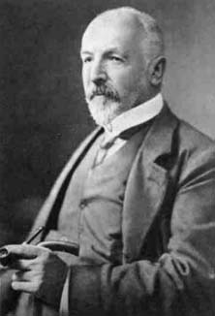
Set Theory and Sizes of Sets
How can we say that two sets are the same size?
Easy for finite sets! What about infinite sets?
Georg Cantor (1845-1918), who invented Set Theory, proposed a way of comparing the sizes of two sets that does not involve counting how many things are in each
Works for both finite and infinite
Two sets are the same size if there’s a one-to-one, onto mapping from one to the other

Slide 18
One-to-one and Onto
f is:
One-to-One
Onto
Correspondence (both (a) and (b))
Neither

Slide 19
One-to-one and Onto
f is:
One-to-One
Onto
Correspondence (both (a) and (b))
Neither

Slide 20
One-to-one and Onto
f is:
One-to-One
Onto
Correspondence (both (a) and (b))
Neither

Slide 21
One-to-one and Onto
f is:
One-to-One
Onto
Correspondence (both (a) and (b))
Neither

Slide 22
One-to-one and Onto
f is:
One-to-One
Onto
Correspondence (both (a) and (b))
Neither

Slide 23
One-to-one and Onto
f is:
One-to-One
Onto
Correspondence (both (a) and (b))
Neither

Slide 24
The TM Acceptance Problem A_{TM}

Slide 25
A_{TM} = {<M,w> | M is a TM, M accepts w}
A_{TM} is:
A language
An operation
A set of strings
A Turing Machine
None or more than one of the above
This is CRITICAL to understand, because most of Thursday’s lecture will be about A_{TM}

