Slide 1
CSE 105 Theory of Computation
Alexander Tsiatas
Spring 2012
Theory of Computation Lecture Slides by Alexander Tsiatas is licensed under a Creative Commons Attribution-NonCommercial-ShareAlike 3.0 Unported License.
Based on a work at http://peerinstruction4cs.org.
Permissions beyond the scope of this license may be available at http://peerinstruction4cs.org.

Slide 2
Non-Regular Languages
On beyond Regular!

Slide 3
Next we’ll be talking about non-Regular Languages
All part of becoming familiar with the boundaries that define these language classes
Closure properties are one way of doing exploring transformations that keep us in the boundaries of the class of Regular Languages
Now we’re bursting through the boundary!

Slide 4
Next we’ll be talking about non-Regular Languages
All part of becoming familiar with the boundaries that define these language classes
Closure properties are one way of doing exploring transformations that keep us in the boundaries of the class of Regular Languages
Now we’re bursting through the boundary!

Slide 5
Next we’ll be talking about non-Regular Languages
All part of becoming familiar with the boundaries that define these language classes
Closure properties are one way of doing exploring transformations that keep us in the boundaries of the class of Regular Languages
Now we’re bursting through the boundary!

Slide 6
Pigeonhole Principle
For the birds

Slide 7
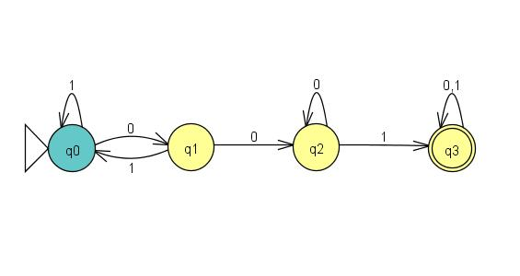
What is the longest string this DFA can accept without visiting any state more than once?
1
3
4
5
None of the above

Slide 8
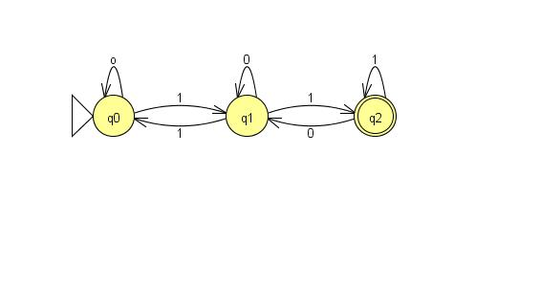
What is the longest string this DFA can accept without visiting any state more than once?
1
2
3
4
None of the above

Slide 9
Generalizing:
Given a string s in L, and a DFA M that recognizes L:
If |s| > |Q|, then when M processes s, it must visit one (or more) state(s) more than once
For a second, let’s just consider one state being twice visited
Let t be the substring of s that is read between the first and second times the twice-visited state is visited
It must be the case that t could appear repeatedly in s:
s = [first part of s]t[last part of s], then also possible in this DFA:
[first part of s]tt[last part of s]
[first part of s]tttttttttt[last part of s]
WHY?? (Discuss in your groups)

Slide 10
The Pumping Lemma Proving a Language is Not Regular
On beyond Regular!

Slide 11
Pumping Lemma
The pumping lemma starts with “If L is a regular language, then...”
We use the pumping lemma to show that a language is:
a) Regular
b) Not Regular

Slide 12
Pumping Lemma
The pumping lemma starts with “If L is a regular language, then...”
The pumping lemma is a guarantee about regular languages.
We use it to show that if a language does not satisfy this guarantee, then it is NOT regular.

Slide 13
The Pumping Lemma: A One-Act Play
Your Script
Pumping Lemma’s Script
“I’m giving you a language L.”
“Uh…sure…let’s just say it’s Regular.”
“Excellent. I’m giving you this string s that I made using your p. It is in L and |s| >= p. I think you’ll really like it.”
“Hm. I followed your directions for xyz, but when I [copy y N times or delete y], the new string is NOT is L! What happened to your 100% Guarantee??!”
“Is L Regular? In this shop I only work on Regular Languages.”
“Thanks. For the language L that you’ve given me, I pick this nice pumping length I call p.”
“Great string, thanks. I’ve cut s up into parts xyz for you. I won’t tell you what they are exactly, but I will say this: |y| > 0 and |xy| <= p. Also, I make you this 100% Guarantee: you can remove y, or copy it as many times as you like, and the new string will still be in L, I promise!”
“Well, then L wasn’t a Regular Language. Since you lied, the Guarantee was void. Thanks for playing.”

Slide 14
How to use the Pumping Lemma Script to write a Pumping Lemma Proof (1)
Let’s look at the parts of your script:
Picking language L:
Done—given to you in the homework/exam problem
Start the proof:
Proof by contradiction: Assume L is regular
Picking p? a) TRUE, b) FALSE
Picking s:
Here you need to get creative
Try several things, remember:
s must be in L
|s| must be >= p (often do this by making some pattern repeat p times, e.g., s = “0^{p}1^{p}” is clearly of length >= p)

Slide 15
The Pumping Lemma: A One-Act Play
Your Script
Pumping Lemma’s Script
“I’m giving you a language L.”
“Uh…sure…let’s just say it’s Regular.”
“Excellent. I’m giving you this string s that I made using your p. It is in L and |s| >= p. I think you’ll really like it.”
“Hm. I followed your directions for xyz, but when I [copy y N times or delete y], the new string is NOT is L! What happened to your 100% Guarantee??!”
“Is L Regular? In this shop I only work on Regular Languages.”
“Thanks. For the language L that you’ve given me, I pick this nice pumping length I call p.”
“Great string, thanks. I’ve cut s up into parts xyz for you. I won’t tell you what they are exactly, but I will say this: |y| > 0 and |xy| <= p. Also, I make you this 100% Guarantee: you can remove y, or copy it as many times as you like, and the new string will still be in L, I promise!”
“Well, then L wasn’t a Regular Language. Since you lied, the Guarantee was void. Thanks for playing.”

Slide 16
How to use the Pumping Lemma Script to write a Pumping Lemma Proof (2)
Let’s look at the parts of your script:
Picking x, y, z? a) TRUE b) FALSE
Picking i (the number of times to copy part y):
For many problems, two main ways to go: i = big: (say, 3 or p), or i = 0 (delete y)
Try both and see if either “breaks” s (makes a string not in L)
If several tries don’t work, you may need to design a different s
End the proof:
Once you find an i/s pair that “breaks” the warranty, this is a contradiction, and so the assumption is false, and L is not Regular. QED.

Slide 17
Pumping Lemma Practice
Thm. L = {0^{n}1^{m}0^{n}| m,n >= 0} is not regular.
Proof (by contradiction):
Assume (towards contradiction) that L is regular. Then the pumping lemma applies to L. Let p be the pumping length. Choose s to be the string _________. The pumping lemma guarantees s can be divided into parts xyz s.t. for any i>=0, xy^{i}z is in L, and that |y|>0 and |xy|<=p. But if we let i = ____, we get the string XXXX, which is not in L, a contradiction. Therefore the assumption is false, and L is not regular. Q.E.D.
s = 00000100000, i = 5
s = 0^{p}10^{p}, i=0
s = (010)^{p}, i=5
None or more than one of the above
I don’t understand this at all

Slide 18
Pumping Lemma Practice
Thm. L = {0^{n}1^{n} | n >= 0} is not regular.
Proof (by contradiction):
Assume (towards contradiction) that L is regular. Then the pumping lemma applies to L. Let p be the pumping length. Choose s to be the string _________. The pumping lemma guarantees s can be divided into parts xyz s.t. for any i>=0, xy^{i}z is in L, and that |y|>0 and |xy|<=p. But if we let i = ____, we get the string XXXX, which is not in L, a contradiction. Therefore the assumption is false, and L is not regular. Q.E.D.
s = 010101, i = 0
s = 000000111111, i=6
s = 0^{p}1^{p}, i=1
s = 0^{i}1^{i}, i=5
None or more than one of the above

Slide 19
Pumping Lemma Practice
Thm. L = {ww_{r} | w_{r} is the reverse of w} is not regular.
Proof (by contradiction):
Assume (towards contradiction) that L is regular. Then the pumping lemma applies to L. Let p be the pumping length. Choose s to be the string _________. The pumping lemma guarantees s can be divided into parts xyz s.t. for any i>=0, xy^{i}z is in L, and that |y|>0 and |xy|<=p. But if we let i = ____, we get the string XXXX, which is not in L, a contradiction. Therefore the assumption is false, and L is not regular. Q.E.D.
s = 000000111111, i=6
s = 0^{p}0^{p}, i=2
s = 0^{p}110^{p}, i = 2
None or more than one of the above

