Slide 1
Welcome!
Please take a group list (only if you don’t have the info already from the email/Moodle)
SIT WITH YOUR ASSIGNED DISCUSSION GROUP IN THE ASSIGNED LOCATION
(Your group can—as a group—move elsewhere for future lectures, if you wish)
Introduce yourselves
Memorize your group members’ faces so you can find them on Thursday

Slide 2
CSE 105 Theory of Computation
Alexander Tsiatas
Spring 2012
Theory of Computation Lecture Slides by Alexander Tsiatas is licensed under a Creative Commons Attribution-NonCommercial-ShareAlike 3.0 Unported License.
Based on a work at http://peerinstruction4cs.org.
Permissions beyond the scope of this license may be available at http://peerinstruction4cs.org.

Slide 3
What is “Theory of Computation”?
The content of many CS courses is perhaps self-explanatory:
Programming in Java
Compilers
Artificial Intelligence
For many of you, what exactly will be covered in “Theory of Computation” may be somewhat mysterious…
Lets EMBRACE it! Mystery is exciting…

Slide 4
Incredibly Practical
What is “Theory of Computation”?
Finite Automata
Hardware design, software engineering
Regular Expressions
A “must-have” programmer’s tool and resume skills bullet point
Foundational for many programming and scripting tasks (Perl)
Context-Free Grammars
Linguistics
Artificial Intelligence
Machine translation (English->Korean)
Turing Machines
All modern computers and programming languages!
Computer architecture (CPU/instructions + RAM)

Slide 5
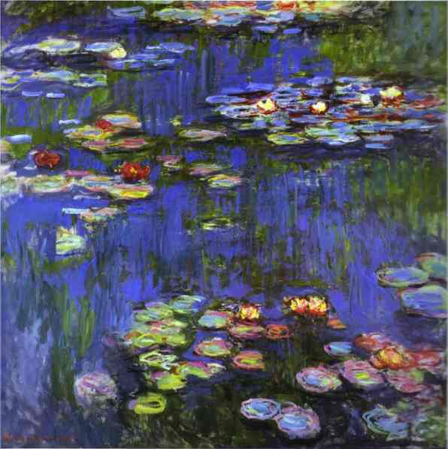
Breathtakingly Beautiful
What is “Theory of Computation”?

Slide 6
How is this exploration of Theory of Computation structured?
Weak = limited uses
Powerful = versatile
Venn Diagram
We will examine a series of abstracted models of computation machines
Start with the most limited
Move towards the most versatile*
Along the way,
Learn how to use each model as a handy tool in your programming life
Become familiar with the contours of each model’s limitations and powers
Prove things about the limitations, about the powers, and about the relationships between models
* Fun fact: this simple-to-complex order is not always the same order in which these were created/discovered
DFA TM

Slide 7
Who Am I?
Soon to be Ph.D. in Computer Science from UCSD
Graph diffusion and clustering problems
Courses I’ve TA’d at UCSD:
105 (twice!), 200, 202 (three times…)
What do I do when I’m not teaching?
Other jobs and research projects:
Several years’ internship experiences at Google and Bell Laboratories
Some work in machine learning theory research

Slide 8
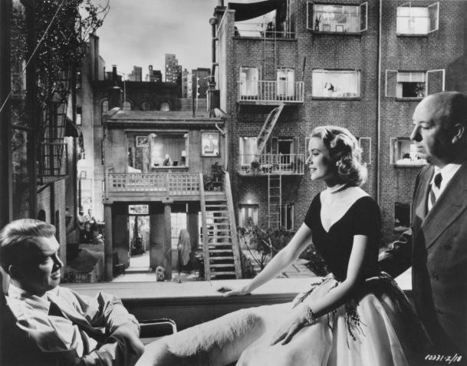
What do I do in this course?
Be your guide in inducing you to explore concepts
Create situations and pose problems that set the scene for your exploration
Me: mise en scène
You: actor/actress
Provide you with feedback
Evaluate your progress
Answer your questions
Not spend lecture reading the textbook to you with slightly different words

Slide 9
What do you do in this course?
Prepare your brain for maximum in-class learning
Reading, reading quizzes
In class: engage with yourself, your neighbors and the class, engage with the ideas—turn them upside down and sideways
iClickers, group discussion
Solidify, refine and perfect your skills
Homework
Certify what you’ve learned, celebrate victories, redirect as needed
Exams
Seek help and seek to help others
In class, moodle forums, office hours, discussion section
The ideas, not your neighbors

Slide 10
Rules for what you do in this course
Reading quizzes
Yes:
Open book; though being able to answer without the book is a good sign
You can retry a question if you answer incorrectly (small penalty), and you can take as much time as you need
Complete them individually
No:
Sharing answers on a reading quiz is as inappropriate as sharing answers on an in-class exam—don’t do it
There is really, really no reason to cheat

Slide 11
Rules for what you do in this course
Exams
Yes:
I will provide notes (theorems and other reference) with the exam booklet
Ask instructor or TA for clarification
No:
Closed book
Closed neighbors and all other unauthorized assistance

Slide 12
Rules for what you do in this course
Homework
Yes:
Open book, open lecture slides and notes, open moodle forums and resources
Working with ONLY your authorized partner, as long as you are both working. It is extremely important that you be prepared to come up with proofs by yourself so you will be ready for the exams
No:
Do not Google for solutions or look for any resources that aren’t provided in moodle or otherwise explicitly authorized
Do not “split up” the problems with your homework partner

Slide 13
Rules for what you do in this course
Class Participation
Yes:
“Click in” and engage actively with your group and with me, even when (or especially when!) you are unsure or struggling
The only way to get through a struggle is to work
If you let me know that you are struggling, by asking a question or by clicker response, I can help—this is a huge favor to me because it helps me steer the lesson in the most helpful direction
Treat other class members kindly and be conscious of creating a welcoming, positive, collaborative team environment
No:
No clicking in for someone who isn’t here, or otherwise feigning participation
I know that everyone has off days, sleepy days, etc, and that’s fine. But please don’t ever allow your behavior to become distracting or rude to anyone else
Mention email etiquette

Slide 14
Thought of the Week
“To be a good geek you have to have both humility and arrogance in equal measures. The humility is so you’ll admit you don’t know something and get help/read the docs/etc. The arrogance is the bit that says “I don’t know that now… but I can and I will soon.””
--Thomas Beagle, IT/programmer

Slide 15
Getting started to-do list:
Register your iClicker at http://iclicker.com
Join our class on Moodle (reading quizzes, other critical stuff): http://csemoodle.ucsd.edu
Log in using ActiveDirectory username/password
Join our class on UP (lecture slides): http://up.ucsd.edu
classroom: CSE 105 SP12
password to join class: recursive (if you don’t have an account, make one—it will have its own password)
Get to know your group
You need to memorize their faces so you can sit by them on Thursday
Take the prerequisite/Ch 0 self-test
Take the Sec 1.1 Reading Quiz (if you haven’t already) before Thursday’s lecture
Download the JFLAP software for designing and simulating automata, get it running on your system (it is a .jar file, you need Java)
Go to discussion Friday or Monday for proof-writing tips
Homework 1 will go out tomorrow evening
You don’t know what automata is, do you? SOON!

Slide 16
Textbook concerns
Introduction to the Theory of Computation by Michael Sipser
Full 2nd edition
Custom 2nd edition
1st or international editions
3rd edition comes out soon…

Slide 17
What other classes are you taking this quarter?

Slide 18
Automata Computational Models
Let’s get started!

Slide 19
What Do Automata Do?
Input strings, output “accept” or “reject”
Every automaton is defined over an alphabet Σ
Ex: Σ = {a,b,c,…,z} or Σ = {0,1}
What does a particular automaton do?
Test every possible string made from Σ
Come up with a set of all the strings that were accepted
Language

Slide 20
Deterministic Finite Automata DFA
They have almost no memory!

Slide 21
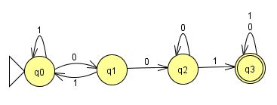
DFA
Show “001” very quickly

Slide 22
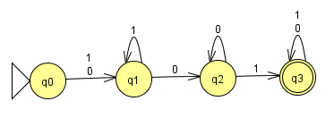
Tracing in a DFA
What is the sequence of states that are followed when running this DFA on the input “111001”?
q0, q1, q2, q2, q3
q0, q1, q1, q2, q2, q3
q0, q1, q1, q1, q2, q2, q3
q0, q1, q1, q1, q1, q2, q2, q3

Slide 23
Tracing in a DFA
What is the sequence of states that are followed when running this DFA on the input “001000”?
q0, q1, q2, q3
q0, q1, q2, q3, q3
q0, q1, q2, q3, q3, q3
q0, q1, q2, q3, q3, q3, q3

Slide 24
Quick review of set notation
Let’s dissect this (assume Σ = {0,1}):
L₁ = { w | length(w) > 3}

Slide 25
Quick review of set notation
Which choice is NOT a string in language L₁ ? (Σ = {a,b,c})
L₁ = {w | w contains more b’s than a’s}
“abbcbba”
“cab”
“bba”
“bccccbcccc”
“bacb”

Slide 26
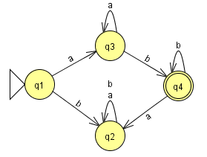
Which is the best description of the language recognized by the DFA M₁? (Σ = {a,b})
Starts with b and ends with a or b
Starts with a and ends with a or b
a‘s followed by b’s
M₁:

Slide 27
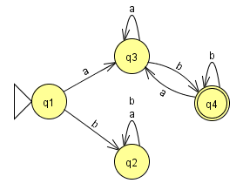
Which is the best description of the language recognized by the DFA M₂? (Σ = {a,b})
Starts with b and ends with b
Starts with a and ends with b
b‘s followed by a’s
M₂:

Slide 28
Communication: An important skill
Describing languages clearly and concisely, like we did in the last problem, is going to be a skill we work on frequently in this course.
Also an issue in proof-writing:
Being concise is a virtue
But leaving out important details is a problem
A conundrum!!
Examples, practice, feedback
More examples, more practice, more feedback
Homework and exams are an official way of doing practice and feedback, but time constraints (yours and the TA’s) limit frequency
A key reason I do group discussion in this course is to provide more opportunity for you to practice putting theoretical ideas into words—learning how to be precise, concise and convincing

Slide 29
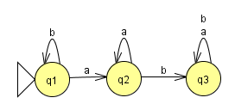
Which states should be in F (the set of “final” or “accept” states) so that DFA M₁ recognizes the language L₁ = {w | b’s never appear after a’s in w} (Σ = {a,b})
F = {q2}
F = {q3}
F = {q1, q2}
F = {q1, q3}
F = {q2, q3}
M₁ :

Slide 30
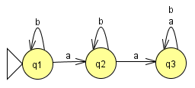
Which states should be in F (the set of “final” or “accept” states) so that DFA M₂ recognizes the language L₂ = {w | w contains less than 1 a or more than 1 a}? (Σ = {a,b})
F = {q2}
F = {q3}
F = {q1, q2}
F = {q1, q3}
F = {q2, q3}
M₂ :

Slide 31
Remember…
Remember I said that in this course, we would,
“Become familiar with the contours of each model’s limitations and powers
Prove things about the limitations, about the powers…”
Not too early to start thinking about this for DFA, so:
TRUE (a) OR FALSE (b):
Deterministic Finite Automata (DFAs) can only recognize finite languages (a language with 1 string or 2 strings or 10 strings or 1,000,000 strings in it), not infinite languages (infinite number of strings in the language)

Slide 32
Automata Simulation Software JFLAP
It’s from Duke University!
What is deterministic?

Slide 33
Getting started to-do list:
Register your iClicker at http://iclicker.com
Join our class on Moodle (reading quizzes, other critical stuff): http://csemoodle.ucsd.edu
Log in using ActiveDirectory username/password
Join our class on UP (lecture slides): http://up.ucsd.edu
classroom: CSE 105 SP12
password to join class: recursive (if you don’t have an account, make one—it will have its own password)
Get to know your group
You need to memorize their faces so you can sit by them on Thursday
Take the prerequisite/Ch 0 self-test
Take the Sec 1.1 Reading Quiz (if you haven’t already) before Thursday’s lecture
Download the JFLAP software for designing and simulating automata, get it running on your system (it is a .jar file, you need Java)
Go to discussion Friday or Monday for proof-writing tips
Homework 1 will go out tomorrow evening
You don’t know what automata is, do you? SOON!

