Slide 1
Lecture 2:
CSE3: Fluency in Information Technology
Please sit in your assigned seat, tutors have lists in lobby if you forgot
Read csemoodle.ucsd.edu
  Homework for next Monday (you don’t turn anything in)
  Joined class late, that’s fine, just do everything under Week 1 and catch up – no penalty.
Go to lab next week!
Meet your Team and Coach: (5 min)
Up Next: Quick Quiz: Get out your iclicker. If you don’t have one today, you can drop this quiz.
  After class – register your iclicker at iclicker.com

Slide 2
Points Earned During Lecture Period
Quiz Questions (3-5 at the beginning of the period)
  No books, no notes (except today), no computers out at all
  5% of your grade, drop your lowest 2
  (No quizzes week 10)
Discussion Questions
  Must get at least 50% correct in each lecture to “get daily point”
  During “group vote” you and your team must vote the same way! (or it’s not counted as correct, even if it is)
  10% of grade, can miss 2 lectures no penalty

Slide 3
Which is true about CSE3 labs
I can drop my lowest lab grade.
I can go to any lab time I like, but I should try to go to the same one each week.
They are optional, but they are very important for allowing me to test my knowledge.
I can attend a different lab section (in case I have to or have missed mine), but I must ask permission first.
Notes:
D

Slide 4
How many different directions can an object be told to move in Alice?
2
3
4
6
More than that
Notes:
D Probably say 6 – up,down,left.right,forward,back (forget forward and back)
Also: There’s move towards another object, etc. So can be E.
YES: There can be more than one right answer, sometimes. And sometimes we ask for the “BEST” answer

Slide 5
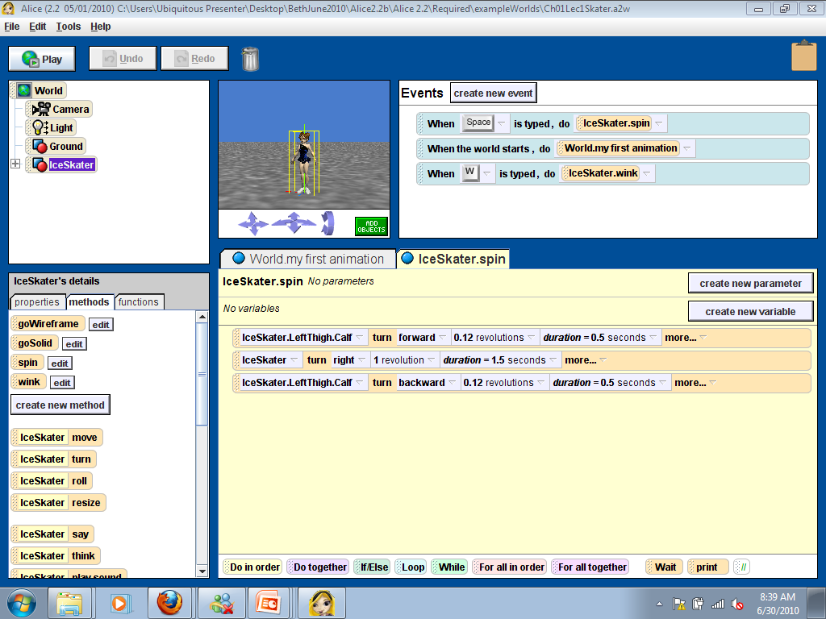
Which area contains our “program” (set of instructions)?
A
B
C
D
Notes:
D

Slide 6
The order in which instructions in a doTogether tile are listed is important (assume no DoInorders inside)
True, because the computer executes instructions one at a time from top to bottom
True, because one instruction is listed after the other
False, because things on a doTogether tile happen simultaneously
False, because you can’t have two instructions on the same tile
Notes:
C

Slide 7
How does this class work?
End of Quiz
During lecture I won’t be “transmitting” information at you
Instead you will be challenged to deepen your understanding of the materials
  By answering challenging “clicker” discussion questions
Process:
  Individual Vote (try for yourself)
  Discuss in Teams of Three (reach consensus)
  Group Vote (everyone vote again, but teams must vote same way)
Let’s Try It!

Slide 8
Which of the following are GOOD metaphors for a computer program?
 | Recipe | Movie Script | To-Do List
A | * | * | *
B | * | *
C |  | * | *
D | *
E |  | *
*In Discussion: Discuss the differences between these things, and be sure you can say why if something is NOT a good metaphor
Notes:
B – because for both a recipe and a script, order matters. It may not on a to-do list.

Slide 9
Why Did We Do That?
It is proven to help you learn better
But I learn from professors explaining in lecture!
  Do you really?
  Have you ever wondered…
Draw mountains
Draw picture of ampitheatre
Show diffusion of knowledge

Slide 10
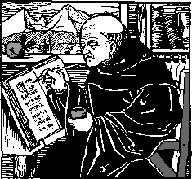
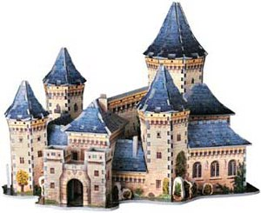
Why do we have lecture?
Draw mountains
Draw picture of ampitheatre
Show diffusion of knowledge

Slide 11

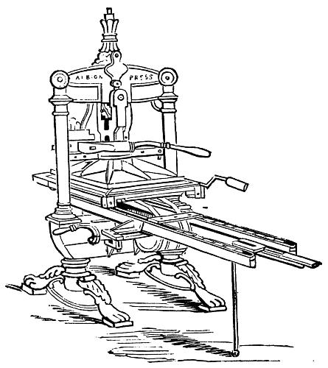


GREAT Innovations:
The printing press, The web
You don’t have the trust the monk!
  Read it and analyze for YOURSELF!
  If I rephrase it for you, what purpose does that serve?
Traditional class structures often look like:
You get very little opportunity for “expert” feedback
Lecture
Textbook
Homework
Exam
First
Exposure
Read Hard Stuff
See if You
Know Hard Stuff
Show Knowledge
Mastery

Slide 12




Peer Instruction-Based Design
Homework
Lecture
Lab
Exam
Q
U
I
Z
First Exposure:
With resources and
Feedback
Learn Hard Stuff:
With teacher and
discussion
Practice
Knowledge
Mastery
Show Knowledge
Mastery
Greater opportunity for expert feedback!
Research on how people learn:
  Everyone constructs their own understanding
    I can’t dump understanding into your brain
  “Lecture” is not an effective forum for learning

Slide 13
Lecture: Peer Instruction
Exploratory Homework: learn basics, play around testing things out to see how they work
Pose question (carefully designed ☺)
  Solo vote: Think for yourself and select answer
  Discuss: Analyze problem in teams of 3 (coach guides)
    Practice analyzing, talking about technical issues
    Reach consensus
    Raise hand if have question/willing to share via microphone
  Group vote: Everyone in group votes
    You must all vote the same to get your point
  Class wide discussion:
    Led by YOU (students) – tell us what you talked about in discussion that everyone should know!

Slide 14
Coaches:
Analysis and Discussion Skills
4 Tas/Tutors serving as Coaches
  Additionally, there are Assistant coaches
    different each day
    3-4 per coach – they may not be able to help you until week 3
Each has a team (same each week):
  9-10 discussion groups (your group of 3)
  They will be “your professor” during discussion
    Rotate around groups guiding discussion
    Giving feedback
    Guiding you in developing analysis and communication skills

Slide 15
Giving out Candy
To people willing to
  Ask a question
  Share an explanation
  Summarize what their group talked about
Using a microphone after the group vote
  You don’t have to stand up, just be a mystery voice from nowhere
Your explanations are CRITICALLY HELPFUL for fellow students’ learning

Slide 16
Chapters 1 and 2
You explored (read and did stuff in Alice):
What might you need to understand more deeply?

Slide 17
Alice Development Environment

Slide 18
What do you call this?
Input
Object
Direction
Control Statement
Instruction/Statement
Notes:
E. It isn’t JUST a method… Methods are on left. Once we drag it into the program, it’s called a statement or instruction – or sometimes “METHOD CALL”

Slide 19
What makes a good discussion?
Not just one thing, we’ll be discussing what makes a good discussion throughout the term
But:
  Not so good…
  A lot better…
Explain WHY and WHY NOT
Discuss OTHER answers (what do they do?)
Everyone talks
  Going back and forth…

Slide 20
If you want to control objects’ positions when setting up a World, select methods from where?
A
B
C
D
Notes:
A: This is important and emphasized in lab because “setting up” the world is different than using controls when “running world (So, use C to select methods you want to drag into the program area for running the world).

Slide 21
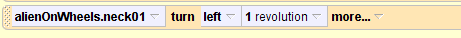

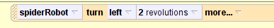
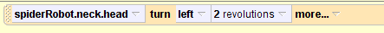
If I want to make a spider robot's head spin around 2 times, what would the instruction (method tile) look like in Alice?
Notes:
Things to talk about are: Object is important. It’s the whole head that turns. And it’s not alien. And parameters. -- could have 1 rev or two, also could have 2 tiles at one rev each, but would go slower

Slide 22
Ways to demonstrate understanding of programming
Scenario: Idea in your head
Design: Storyboard
Implementation: Program
Writing
Reading
Produce a result/artifact
Communication among people
Debugging

Slide 23
Writing:
Textual Storyboarding to Programs
Given a visualization of what something should do
  Or here an actual movie created in Alice
Can you write a textual storyboard to describe the action?
Later on: Can you translate that textual storyboard into Alice instructions?
Notes:
Go to next page

Slide 24
Analysis Practice
Next: I’m going to “play” an Alice movie
Watch CLOSELY, and
pick which storyboard reflects what you see
I’ll play it a couple times
Notes:
Go to next page

Slide 25
For the video, which textual storyboard best represents what you see happening?
A
Do these steps in order
Girl turns toward boy
Girl moves a small amount towards boy
Boy moves a larger amount towards girl
Boy turns toward girl
C
None of
the Above
B
Do these steps in order
Girl turns toward boy
Do the following steps together
Girl moves a small amount towards boy
Boy moves a larger amount towards girl
Boy turns toward girl
Notes:
Show video 1st, Read, show video again, then vote
B – A and has no do together
C and D have the boy turning BEFORE walking together

Slide 26
What’s wrong with this storyboard?
Do these steps in order
Girl turns toward boy
Boy turns toward girl
Do the following steps together
Boy moves a larger amount towards girl
Girl moves a small amount towards boy
An instruction is out of order
The “larger” and “small” statements are in the wrong order
Nothing, it works just like the previous one
Notes:
A. The 2nd line (both turns toward girl) should be after the do together

Slide 27
Writing:
If you are given “a video”
  Can you see the (very detailed) steps that took place?
    Can you identify order and other characteristics (doing things together versus in order (sequentially))
Notes:
Variant of A – because they didn’t generate – I did and they picked the right one.

Slide 28
Writing:
A) Design: Can you express your understanding of the steps in a textual storyboard
  Including the special characteristics?
B) Implement: Can you translate your storyboard into Alice instructions? (code)
We just did a variant of A,
let’s try B, but we’ll work one instruction at a time
Notes:
Variant of A – because they didn’t generate – I did and they picked the right one.

Slide 29
Remember, this is our storyboard
Do these steps in order
Girl turns toward boy
Do the following steps together
Girl moves a small amount towards boy
Boy moves a larger amount towards girl
Boy turns toward girl

Slide 30
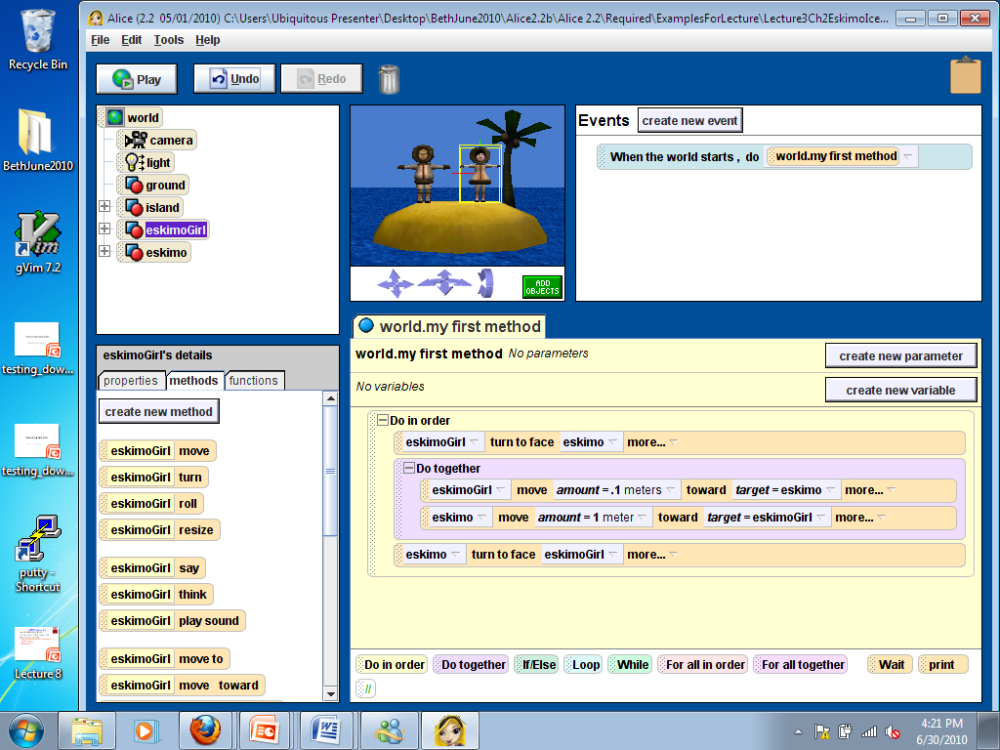
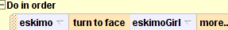
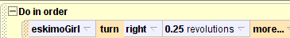
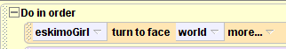
Girl turns toward boy
A
B
C
D
E More than one of the above
Notes:
E both A and C. Because she starts out facing forward AND because the eskimo is directly in line to the right of her. But turnToFace is usually safer, as you don’t have to worry about exact location issues. Point out that this difference between turnToFace and turn.25 is an ingredients issue not technique

Slide 31
The rest…
What more do we need to do (after the previous statement) to create the rest of the program?

Slide 32
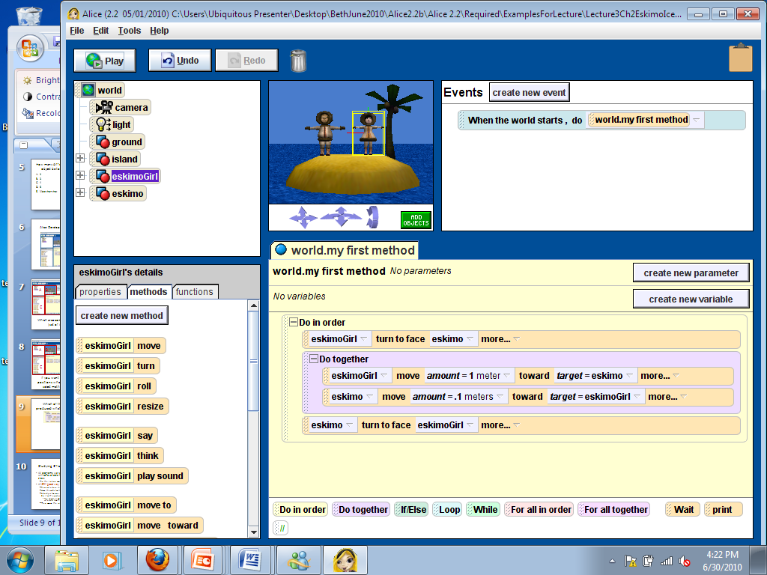
Do these steps in order
Girl turns toward boy
Do the following steps together
Girl moves a small amount towards boy
Boy moves a larger amount towards girl
Boy turns toward girl
If you can’t see, the amounts are:
ONE
And (zero) POINT ONE
A
B
C None of the Above
Notes:
B: The girls moves only a bit, the boy moves a lot AND (not B) because boy turns at end

Slide 33
That was Writing, Now Reading
Given an Alice program (or part of a program)
Be able to read it and describe what code does (scenario)
  In English, since we’re not making you draw or even give the storyboard ☺

Slide 34
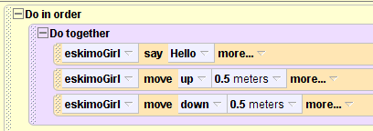
What does this code do?
Makes the eskimo girl say Hello, then jump up and down
Makes the eskimo girl say Hello WHILE jumping up and down
Makes the eskimo girl say Hello
None of the above
Notes:
Answer is C – since move up and move down cancel out

Slide 35
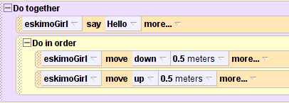
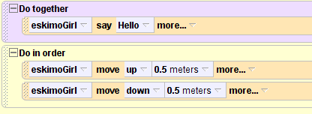
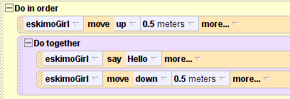
How would we change the code to make her say Hello while jumping up and down?
Notes:
Answer is D: To make it really jump up and down (put last two statements in do in order)– modify B so that the do in order is IN the dotogether

Slide 36
Note: Our intent in NOT to “trick you”
Computer programs are PICKY
Getting them to do what you want requires paying attention to a lot detail
  In computing, getting the computer to do EXACTLY what you want is often very important
  Flying planes:
    A BIT too close is TOO CLOSE!
    Red light cameras better not ticket me when the light’s yellow

Slide 37
Methods you might like to use
(and you should play with)
move vs turn vs roll
The “as Seen By” modifier
  Can make moving, turning or rolling behave differently
OrientTo
PointAt
Duration and Style modifiers (abruptly, etc.)

