Slide 1
Lecture 9
Midterm in one week!
  Today – practice explain question
  Sample midterm up tomorrow
  How do you study? (see next slide)
Don’t forget Alice Project Deliverable 1 due next Monday before class

Slide 2
How To Study For Exams in CSE3
(also redo homeworks and labs (or at least review) )
You will need a red half-page scantron -- bookstore
Re-Take Clicker questions (not just “review” them)
  Print out the questions and sit with someone else
  Read a question, come up with your answer (1-3 minutes)
  You say to your partner:
    I thought it was A because. And B is not right because and C is not right because and D is not right because
  Your partner interjects with their explanation in their own words as you go along (take turns going “first”)
  THEN see if you got it right
    Confused? Go to the moodle and watch the video, fast forwarding to this slide. Listen again to discussion. Talk more with your partner. Ask tutors how they would explain it.
  Take down a few notes on what the key thing to know from this slide is
Notes:
With that motivation…

Slide 3
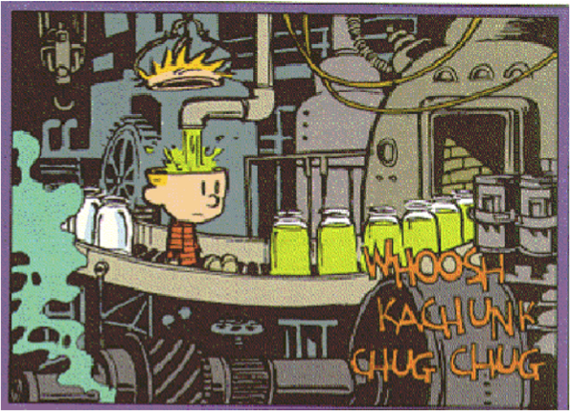
Comment from a previous student:
“I feel the instructor really knew the material. I wish she had used this to her advantage and would have taught the class everything we needed to know. I had to learn it myself.”

Slide 4

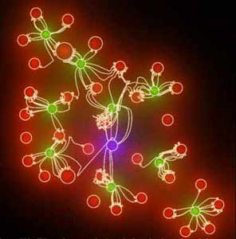

knowledge
understanding
Notes:
I used to how to do double and triple integrals… I don’t now… that lasted about 1 month.
Worse, I don’t think I ever UNDERSTOOD double or triple integrals… I just knew the PROCESS by which you solved them. That’s because I never really had it explained to me why they are useful… or maybe someone said one sentence on it or something… They focused on the KNOWLEDGE of how to do them.

Slide 5
Why we do what we do in this class
My teaching expertise to guide in developing understanding (not “telling you knowledge”)
  Homework, Discussion, Lab
But what you ask us to do (Alice, explaining)…
I don’t see how it helps us!
  Authentic tasks (not “school” tasks)
    What people who “can work with computers” do
  Let me tell you how I started to understand the importance of this difference…

Slide 6

Notes:
The way Carl tells it, when he was in undergrad, he didn’t really learn much about physics that led him to be successful in the field by going to “class”. Instead, he hung around in the graduate student labs where they were doing research, trying stuff out, talking about things that worked, things that didn’t…. He hung around “real working physicists”. And all the things they were doing are called “authentic activity”. (it’s NOT doing word problems at the end of the book).

Slide 7


Notes:
The way Carl tells it, when he was in undergrad, he didn’t really learn much about physics that led him to be successful in the field by going to “class”. Instead, he hung around in the graduate student labs where they were doing research, trying stuff out, talking about things that worked, things that didn’t…. He hung around “real working physicists”. And all the things they were doing are called “authentic activity”. (it’s NOT doing word problems at the end of the book).

Slide 8
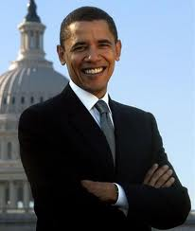
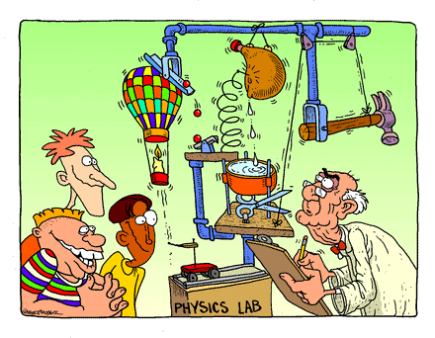
Authentic
activity
Notes:
The way Carl tells it, when he was in undergrad, he didn’t really learn much about physics that led him to be successful in the field by going to “class”. Instead, he hung around in the graduate student labs where they were doing research, trying stuff out, talking about things that worked, things that didn’t…. He hung around “real working physicists”. And all the things they were doing are called “authentic activity”. (it’s NOT doing word problems at the end of the book).

Slide 9
Authentic Tasks*
These are the ways in which effective computer-savvy people WORK in their actual practices!
Cognitive Apprenticeship
  Simple tasks representative of expert behaviors
  Develop and apply skills in REAL WORLD environment
Why computing? Math, sure, I use that in my major…
Brown, Collins, Duguid. Situated Cognitions and the Culture of Learning
Educational Researcher, 18(1).

Slide 10
Computing Will Pervade Your Life:
Your Resume
No, you won’t put down “CSE 3 taught me Excel and Alice”
  “Common” computing application proficiency EXPECTED – not something to brag about
CSE3: Fluency with Information Technology
  A course designed to develop computational thinking skills to support a computationally savvy 21st century workforce. Learning goals of the class include development of analysis and communication skills to enable life-long learning in the technological realm.

Slide 11
Why is “Loop” also called “Counted Loop”
The loop makes things happen an indefinite number of times dependent on object positioning
The loop makes things happen exactly 10 times
The loop makes things happen a definite number of times
Notes:
C. Not just 10 – but some specific number of times.

Slide 12
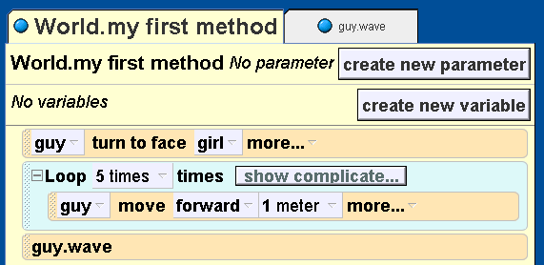
The program below has a guy walk toward a girl waving…
Before he walks toward her
As he walks toward her
Once he finishes walking toward her
Notes:
C– since it is outside of the loop and after it

Slide 13
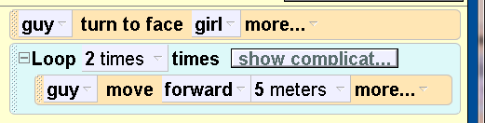
When the code is done, how far will the guy have walked?
2 meters
5 meters
7 meters
10 meters
Notes:
D) 10 meters. 5 meters at a time, 2 times.

Slide 14
Midterm Practice!
Clicker Discussions help you develop and home your ability to analyze and communicate technically
You can show us your skills on an exam through a written “explanation” of a multiple choice question
Guideline Review:
  Make clear your understanding of the question by analyzing it and explaining what it means/is asking for
  Use appropriate terminology
  Don’t just “re-write” code if you need to explain it, use words that make it clear you understand how it works
  Explain why the wrong answers are wrong

Slide 15
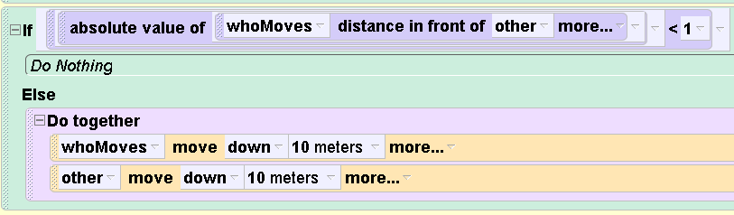
What if we replaced our if with this?
It does the exact same thing
It does the exact opposite (game is over if too close together)
It almost does the exact same thing,
but not quite
I don’t know
Feedback
Paraphrase
Justify
Notes:
C – this does game over when distance is EXACTLY one meter OR more (>= 1)
only lets you keep playing if distance LESS THAN one meter

Slide 16
Picky, Picky
Yeah, you would be too if you earned a 90% and you got a B!
  >= 90% gets an A
  < 90% and >= 80% gets a B

Slide 17
Additional Midterm Practice:
Can you figure this out?
How do we determine who wins?
If one of our players is within .5 meter of stop sign (use distance to)
  Then have they should say “I Win!”
  And the loser has to do a silly dance
It’s not possible that they will both get there at same time (sequentializes keypress detection)
Notes:
Leave this as practice for students

Slide 18
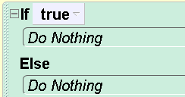
Evaluate my code
Last term some Alice projects used if statements in weird (and WRONG) ways
  If (true) or if (false)
  Empty “body”
  Things were “backwards”
  Nothing in “then” – just in “else” part

Slide 19
Imagine my project…
The synopsis is
  A boy and a girl start off 5 meters from a tree. They walk up to a tree, and when they are “close enough” to it (less than 2 meters), the tree leaves change color (turn red)…
This is my code

Slide 20
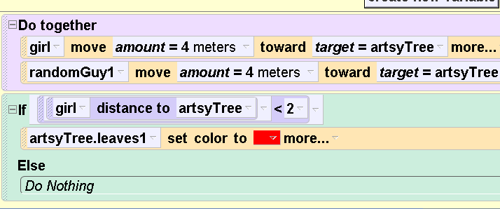
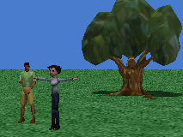
How would you analyze this code?
Feedback
Paraphrase
Justify
Good job Beth! This will make the leaves turn red as described
The boolean expression is wrong you shouldn’t
use <
The if statement is set up wrong, you also need to check the randomGuy distance to
Beth got it wrong, this code should not use an if statement
Notes:
D. Since you start off 5 meters away and walk 4 meters towards it you WILL ALWAYS be close enough!!!

Slide 21
A New Discussion Technique:
Stop and ask for confirmation, use an Example
Student 1 I thought a parameter name, I thought the calling
object was the actor in the action, so I thought it was
the parameter is not the primary actor,
Does that make sense?
Student 2 Umm, you’re saying the calling object is not the
parameter? It’s different?
Student 1 Yeah, the calling object isn't the parameter, but the
parameter still helps with stuff, and then, the
parameter's different from the calling object,
Student 3 I think that’s true, but you can have another object of
that class as a parameter – An example would be when
we could have an eskimo turn to face another eskimo

Slide 22
How many of the following statements are true: Use an if-statement when
You have an animation that always does the exact same thing
You have an animation whose action can vary based on some circumstance
0 B) 1 C)2
STOP, ASK
PARAPHRASE
EXAMPLE
Notes:
2 only
If an animation has variable action, does it HAVE to use an if statement? No, it could just use events to control it..

Slide 23
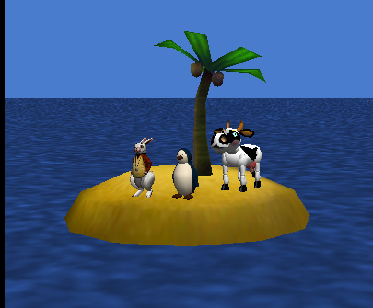
What does this code do?
World with three “drivable” objects
  Forward, Turn by .12 revolutions (1/8th of the way around)
  Midterm Practice:
  How many events
  would I need and
  what would they
  control? (hint > 4)
The scene:

Slide 24
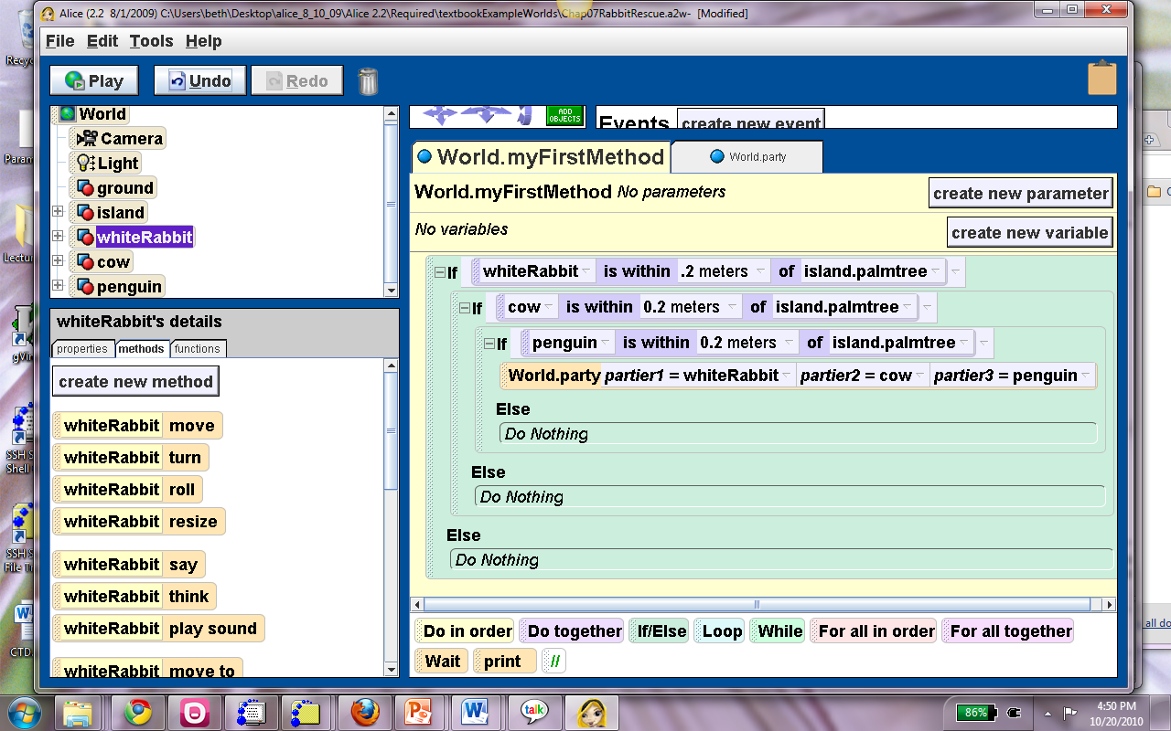
This code lives at the end (bottom) of “forward” event handlers (not turn)

Slide 25
What is this code checking for?
(e.g. when will the party method be called)
To see if any of the objects is near the palmtree
To see if the penguin is near the palmtree
To see if all of the objects are near the palmtree
STOP, ASK
PARAPHRASE
EXAMPLE
Notes:
C.
A – check – what if it’;s just the cow? What if it’s just the penguin, What if it’s just the rabbit? If not the rabbit, jump to ending else
B – if the rabbit isn’t close, we don’t even check!

Slide 26
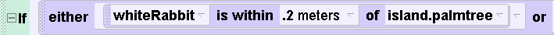
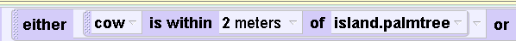

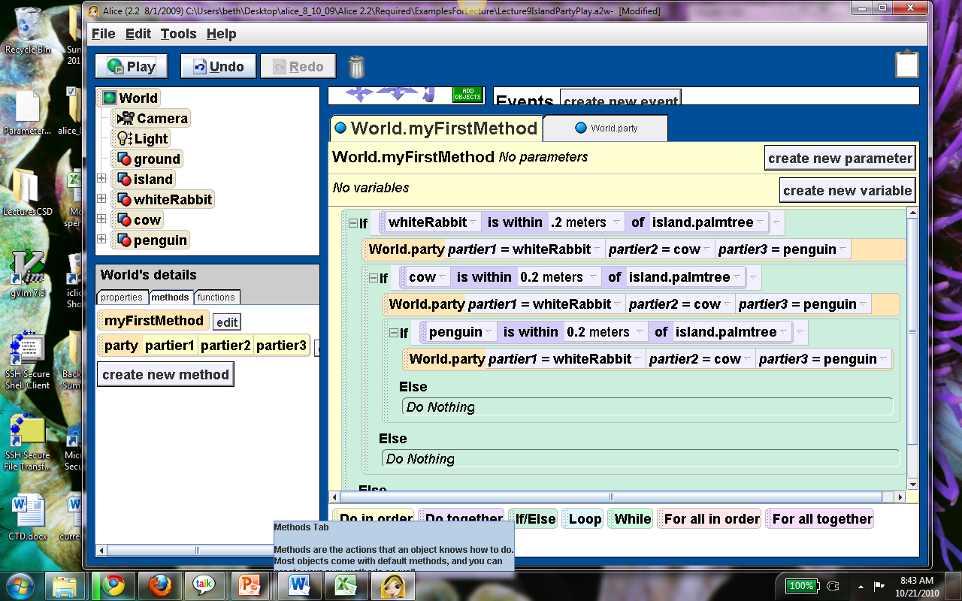
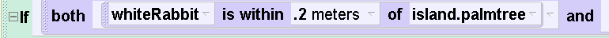
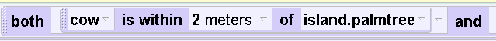

Do any of these do the same thing?
(if all the objects near the tree)
STOP, ASK
PARAPHRASE
EXAMPLE
Notes:
B) AND is what is needed to require that they ALL be near the tree.

Slide 27
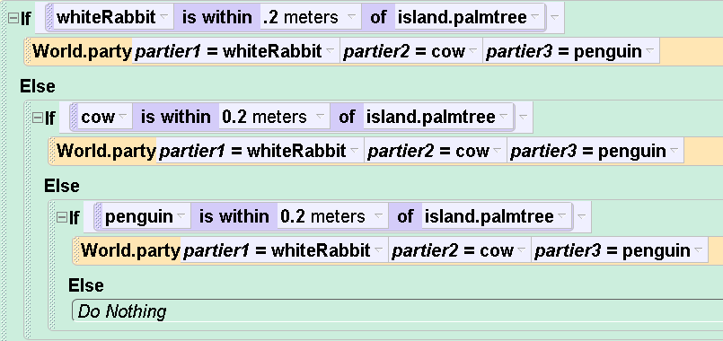
When does a party happen?
If any of the objects is near the palmtree
If all of the objects are near the palmtree
Something else (e.g. multiple parties…)
STOP, ASK
PARAPHRASE
EXAMPLE
Notes:
A. If any object is close, they party, but then it DOESN’T CHECK any of the other conditions (since they are in else’s), so only ONE party happens… but which line of code actually “runs” to make the party happens depends (but does a USER care? Maybe not)

Slide 28
If any object is near the palmtree:
Compound Boolean Expression
(copied from one line in Alice)

Slide 29
Review
both __________ and ______________
either ___________ or ___________ or both
Not
When trying to read, match up the words above

Slide 30
Aside: Designing if statements that use parameters as objects
Wierdism… not real programming
See online video
Follow this process
  1) “cheat” by picking an actual object from the object tree, and then picking from it’s function set in the left right
  2)Then drag the parameter object you want on top of the object name that you just “cheated” with and it will replace it.

Slide 31
Chapter 7: Repetition
7.1 Definite loops (counted)
7.2 Conditional loops (indefinite)

Slide 32
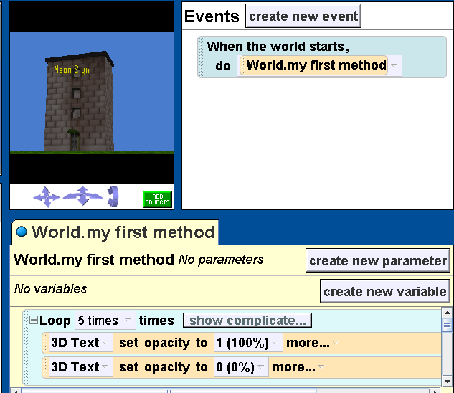
A blinking neon sign

Slide 33
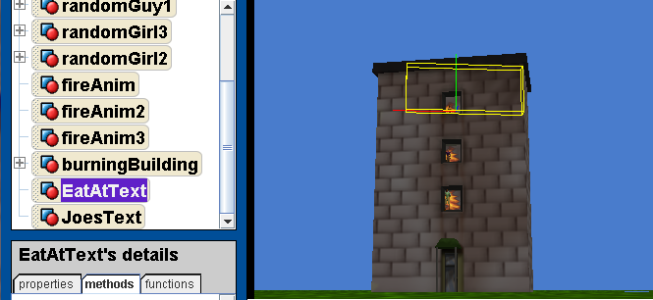
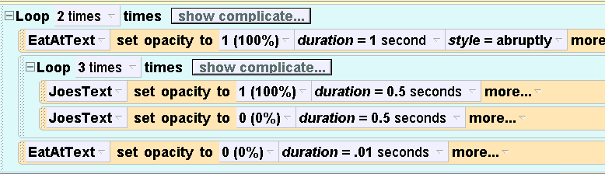
What does this code do?
How many times does it flash…
Start off with 3-D text
objects at opacity 0
(invisible)

Slide 34
How many times does it flash…
 | EatAt | Joes
A | 2 times | 3 times
B | 2 times | 6 times
C | 3 times | 2 times
D | 3 times | 6 times
STOP, ASK
PARAPHRASE
Another
EXAMPLE
(change the #s)
Notes:
Demo – EatAtJoes
Answer B: Eat At Is outer loop – goes 2 times. Joes is inner loop – goes 3 times for every one time EatAt Flashes

Slide 35
How can I mess around with this code?
Make EatAt flash and disappear, before Joes flashes 3 times.
Make EatAt appear at the same time as Joes flashes 3 times
Make Joes come on first, and EatAt flash several times while Joes is on…
Change the number of times each flashes…
Add a third 3-D text saying “Crab Shack” and have that flash 5 times for each time EatAt flashes 1 time
Add a third 3-D text saying “Crab Shack” and have that flash 5 times for each time Joes flashes 1 time

Slide 36
Bunny Square Dance
We want to direct the bunny to hop in a square pattern. The “length” of each side of his square should be 5 hops.
Here’s the structure of our code, what numbers would you put in for each missing number?

Slide 37
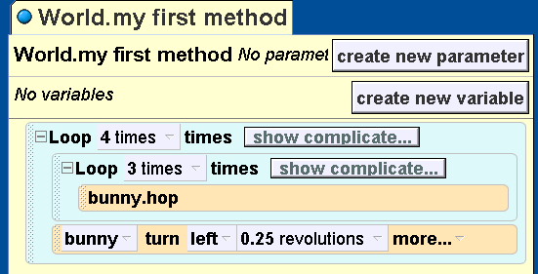
 | Outer Loop count | Inner Loop count | Turn parameter
A | 4 | 5 | .25
B | 4 | 5 | 1
C | 5 | 4 | .25
D | 5 | 4 | 1
Goal: Hop in a square, 5 hops on each side
Notes:
A) Outer loop runs 4 times – as there are 4 sides to the square. The inner loop runs 5 times, since there are 5 hops per side… Turn ¼ revolution at each corner. Demo… Lecture 10 BunnySquareDanceDone.a2w

Slide 38
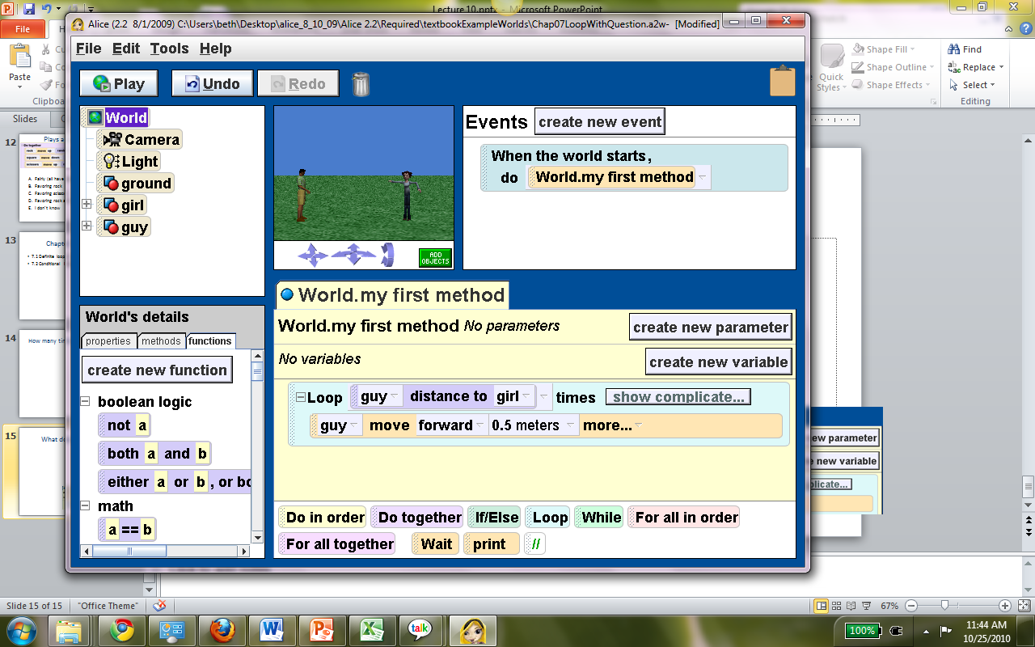
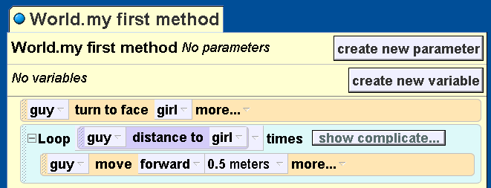
What does this code do?
Makes the guy move “up close” to the girl
Makes the guy move toward the girl, but not all the way toward her
Makes the guy move toward the girl and then go on past her
I don’t know
Notes:
B) Disatnce to girl is 3 meters. It’s calculated once – before the loop starts executing. So, since he moves only ½ a meter per time, he’ll only get distanceTo * .5 meters there. (or half way). For every meter away he is, he only walks .5 meters forward. For 6 meters, he’ll move forward 6 times .5 meters each.

Slide 39
The primary benefit of using a function to control the number of times a loop runs is…
The function can be used to make the loop run a fixed number of times
The state of the world can be used to calculate how many times a loop should run
The function can be used to allow the loop to run forever.
I don’t know
STOP, ASK
PARAPHRASE
EXAMPLE
Notes:
B. E.g. we can have the boy walk up a different number of meters to the girl, depending on the state of the objects in the world.

Slide 40
Games:
Infinite loops and events
Set up:
  A bunny, a cat, and a hawk all “move” in “squares” 2.5 meters on a side
    moving forward .5 meters at a time
  An anvil hovers above their head
Game:
  When I click on an animal, the anvil drops down and “smooshes” them (they go invisible) then the anvil returns to it’s place so I can click again
  An infinite loop is used to keep all the animals continuing to move in their square patterns
Notes:
Demo: Load AnvilsPetInfinite – and play it DON’T SHOW IT

Slide 41
In the nested loops that control this code how many times should the loops run?
 | Outer Loop | Inner Loop
A | 5 | 5
B | 5 | Infinite
C | Infinite | 5
D | Infinite | Infinite
E: I don’t know
Notes:
C – inner loop traverses each side, outer loop controls how many “sides” to do

