Slide 1
Creative Commons Attribution Non-Commercial Share Alike License
http://creativecommons.org/licenses/by-nc-sa/3.0/
Original Developer: Beth Simon, 2009 bsimon@cs.ucsd.edu

Slide 2
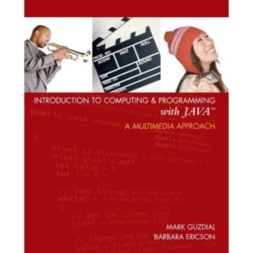
CSE8A Lecture 27
Read next class: Re-read Chapter 2
PSA9 due WED 11:59pm (pair – Make a class for Participant in medical study)
Exam: Wed 3-6pm
Individual and Group
Survey Linked from Moodle under sample exam (up by Friday 5pm)
Study CLICKER QUESTIONS (and quizzes, labs, PSAs, practice writing code)
Review Session
Friday:
Quiz (more points for you, practice for final)
TA evals
Microsoft Filming…
If you don’t want to be filmed, let your group know, sit in roped off area

Slide 3
Lab 4: Grades will be assigned as average if missing: Who is missing… (vote A for each lab, multiple votes)
Lab 3
Lab 5
Lab 6
Lab 8 (week 8, lab 7)

Slide 4
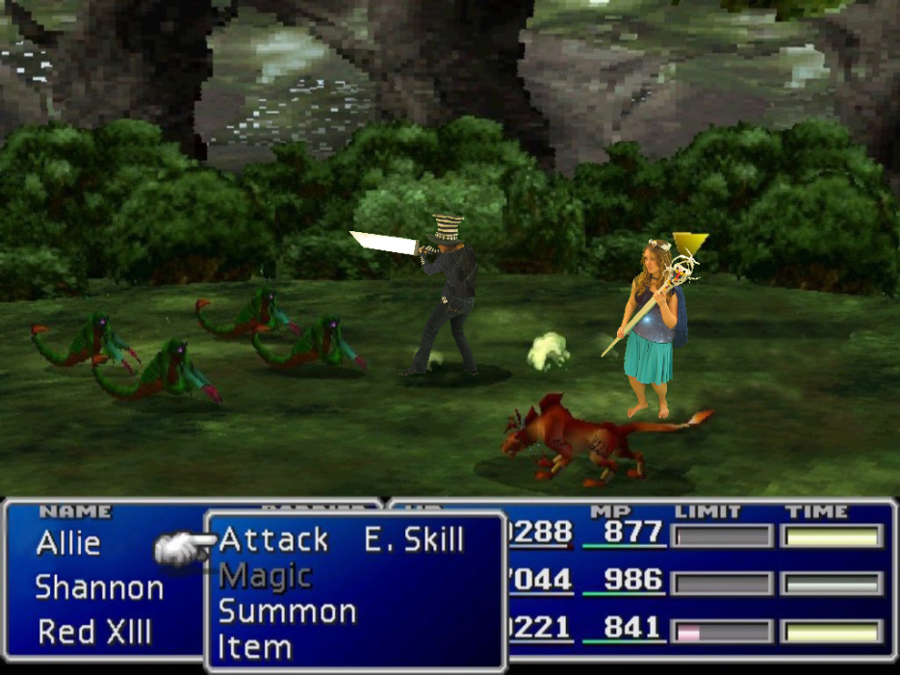
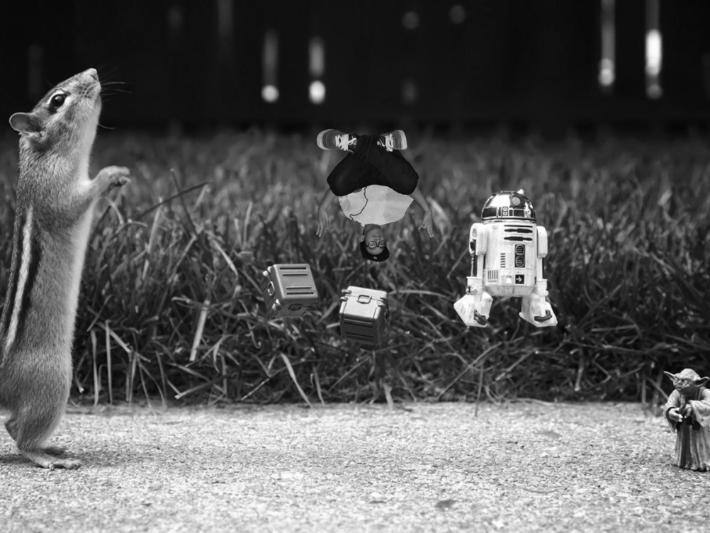
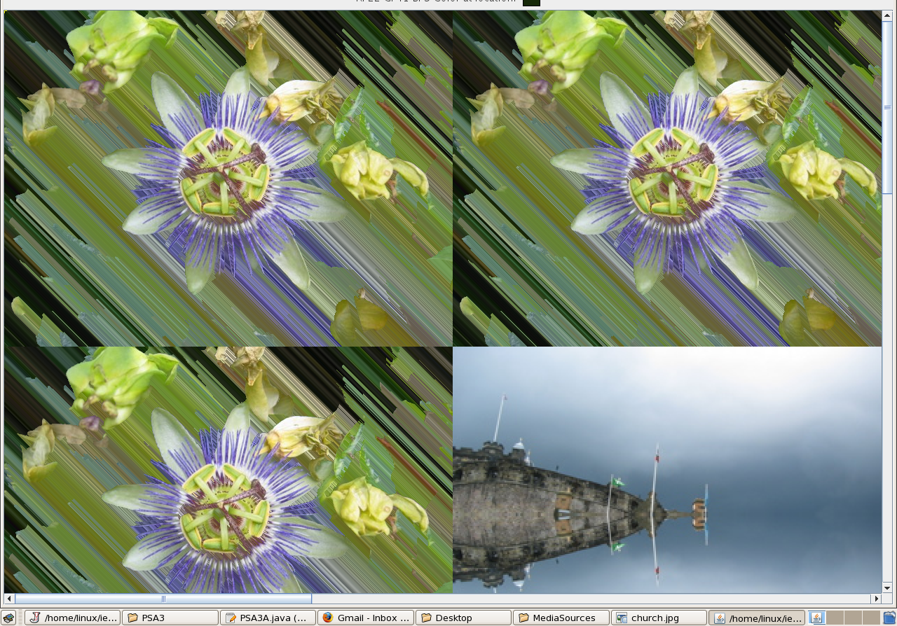
CSE8A Art Exhibition!!! Honorable Mention

Slide 5
CSE 8A Art Exhibition Grand Prize

Slide 6
When can you make review session? (just vote A when I call that time, we’ll do multiple votes)
Monday 10-11
Monday 12-1
Monday 3-4
Tuesday 10-11
Tuesday 12-1
Tuesday 3-4

Slide 7
By the end of today’s class you should be able to…
LLG54: Be able to draw the memory model of an object (at a more detailed level than before) – based on what happens in a constructor.
LG55: Identify legal and illegal instances of method overloading, so you can know what “variations” on methods you can write.
LG56: Create arrays of objects of any length or type and be able to use good software design for using arrays as fields

Slide 8
Our Species class example
public class Species
{
///////// fields ////////////
private String name;
private int[] population;
private double growthRate;
/////// constructors ///////////
/////// methods ////////////////
}

Slide 9
Review: Draw what happens here… (hint pg 357)
public Species(String newName, int[] newPop, double newGR)
{ name = newName;
for (int i=0; i< this.population.length;i++)
population[i] = newPop[i];
growthRate = newGR;
}
DO YOU UNDERSTAND? There’s a missing line that causes an error – what is it?

Slide 10
Review: Keeping our data secure (pg 356 is insecure)
public Species(String newName, int[] newPop, double newGR)
{ name = newName; population = new int[newPop.length];
for (int i=0; i< this.population.length;i++)
population[i] = newPop[i];
growthRate = newGR;
}
public Species(String newName, int[] newPop, double newGR)
{ name = newName; //BAD DESIGN… INSECURE
population = newPop;
growthRate = newGR;
}

Slide 11
Why? Remember there is a main program that sent in “newPop”
public static void main LabX(String[] args)
{ int[] mypop = {30,455,2,0,6376};
Species s = new Species(“Naked Mole Rat”, mypop, 3.3);
}
public Species(String newName, int[] newPop, double newGR)
{ name = newName; //BAD DESIGN… INSECURE
population = newPop;
growthRate = newGR;
}

Slide 12
Which is more secure?

Slide 13
Modifying the Species class
This idea that the population array is just 5 entries, one per continent is a bit “obscure”.
What if we have 2 arrays that are “linked” from a design point of view.
One keeps the name of the “place”
One keeps the population of the animal in that “place”
What would my instance variables be?
Be sure to call the String[] location
Draw them – samples.

Slide 14
Write a constructor for the new Species class
public Species(String newName, int[] newPop, String[] location, double newGR)
{ name = newName; population = new int[newPop.length];
for (int i=0; i< this.population.length;i++)
population[i] = newPop[i];
<<INSERT CODE HERE>>
growthRate = newGR;
}
location = new String[location.length];
for (int i=0; i < location.length; i++)
location[i] = location[i];
location = location;
this.location = location;
location = new String[location.length];
for (int i=0; i < location.length; i++)
this.location[i] = location[i];

Slide 15
Write a constructor for the new Species class
public Species(String newName, int[] newPop, String[] location, double newGR)
{ name = newName; population = new int[newPop.length];
for (int i=0; i< this.population.length;i++)
population[i] = newPop[i];
location = new String[location.length];
for (int i=0; i < location.length; i++)
this.location[i] = location[i];
growthRate = newGR;
}
Still has some “bad software design issues…”

Slide 16
What is this code doing?
public Species(String newName, int[] newPop, String[] location, double newGR)
{ name = newName;
growthRate = newGR;
if (newPop.length != location.length)
{
System.out.println(“Error constructing Species. “+
“Population array and location array must be same length.”);
population = null; location = null;
return;
} population = new int[newPop.length];
location = new String[location.length];
for (int i=0; i < location.length; i++)
{ this.location[i] = location[i];
this.population[i] = newPop[i];
}
}
Making sure newPop and location are legal
Making sure newPop and location are of the same length
Setting population and location to null
Error, return without variable

