Slide 1
Lecture Mon Week 8
Tech and Society #2 Due Tuesday 11:59pm!
  Survey AND Forum post
Exam solutions posted (except written answer)
  Question 7 – let’s do this together later
Today Finish up Alice 9.1 and 9.2 (Lists and Search)
Wed: Excel!
  Are you ready? See moodle!

Slide 2
Which best describes your interest in taking a future computing course?
Not interested
Maybe interested, not sure
Interested, but I have no time in my schedule
Interested, I would like to take CSE8A (or other course) sometime
Interested, I want to get into a computing course next term!

Slide 3

Which statement is true about the following function?
It returns an Object
It returns a Number
It returns either true or false
It makes a (random) mole pop up
Notes:
A. Since moles is a list of Objects – random item from doesn’t ALWAYS have to return an Object… we could have a list of other things…

Slide 4
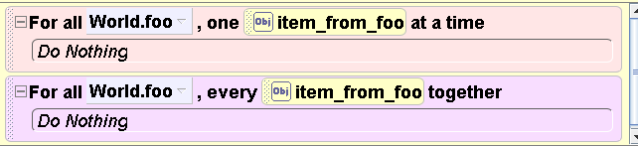
Are these “for all” tiles loops? Why?
No, neither For All Together or For All In Order makes things happen multiple times
Yes, only the For All In Order is -- it makes the same thing happen to all the items in the list
Yes, both the For All Together and For All In Order tiles make the same thing happen to all the items in the list
Notes:
C. Both of them make some set of actions happen to all the items in the list… (just in order or all together)

Slide 5
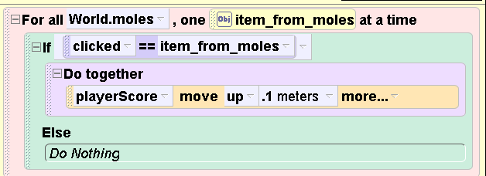
Explain in English what the purpose of code below:
To see exactly which mole was clicked on
To increase the score if you clicked on any of the moles
To see if the game is over
Notes:
B. It checks over the whole list of moles in order… and checks to see if you clicked on one of them… if so, the playerScore cylinder moves up a small amount.

Slide 6
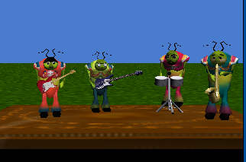
Let’s make the beetles do a more complicated dance…
Like this:
Notes:
Show video: Chapter9BeetlesNestedLoopsGood (don’t describe the below – the next question is on this)
This has for each beetle one at a time – move forward
Then after one guy moves forward – they ALL spin around one revolution (for all together)
Then that beetle moves backwards

Slide 7
Which structure would you want?
One ForAllInOrder loop
One ForAllInOrder loop with an if statement inside
One if statement with a ForAllTogether inside
None of the above
Notes:
NOTE: Replay the video many times while they think about this.
Big Idea: Having a loop over elements of a list inside another loop over the elements of that SAME list. Reinforces that the inner loop does all it’s work (loops however many times it should), before the outer loop does the next iteration. However, in this question, it’s just getting them to realize there are two “sets” of looping happening.
Correct Answer and Why:
D. None of the above…
It’s a ForAllInOrder (over the beetles list) with a ForAllTogether inside – where they all turn 1 revolution
<<ACTUAL BUGGY CODE NEXT SLIDE – BE CAREFUL HOW MUCH YOU DISCUSS, THEY WILL GO ON TO FURTHER EXPLORE, DON’T GIVE IT AWAY>>
(BTW, the code would actually look like)
For All Beetles one Item_from_beetles time
Item_from_Beetles.move(forward) 1 meter
For All Beetles every item_from_beetles2
item_from_beetles2 turn 1 revoluton
Item_from_Beetles.move(backward) 1 meter
Why Might Students Pick Other Answers/What Sort of Questions Might Be Asked: (AGAIN, LIKELY DON’T DISCUSS VERY DEEPLY UNTIL YOU DO THE NEXT SLIDE, BUT YOU MIGHT WANT TO COME BACK AND RE-DISCUSS THIS AFTER)
If they just ignore the fact that the beetles all spinning around requires a loop (OK, it wouldn’t HAVE to, but that would be bad design – you could have 4 statements inside the forallInOrder on a DoTogether tile having them each spin one revolution, but that is bad design since you would have to modify your code if you were to add one beetle to the band (e.e.g have 5 beetles in the list or 3 beetles in the list of 100 neetles in the list, which is the case which makes it obviously a bad design).
The if statement is tempting since there is only one beetle moving forward at a time, and the previous question used an if statement to control which froggie would say what. But you don’t need It – inside the for all in order you’ll just have the item_from_Beetles list move forward.
The if statement with a forAllTogether inside reflects that, yes, you do want a ForAllTogether to make them all turn around at one, however you can’t JUST have an if statement, as you want each beetle in the list to move forward – a repeated pattern, not a selection (if) pattern.

Slide 8
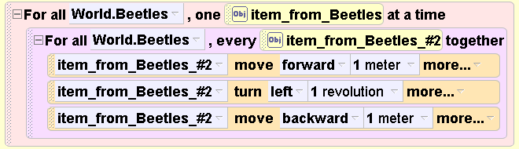
Does this code correctly implement our intended behavior?
Yes
No
I don’t know
And WHY!
Notes:
Big Idea: We have two nested loops, but one needs to think about what actions happen in which loops. Not everything is necessarily happening in the innermost loops. You can have statements in the outer loop that happen before (or after) the inner loop.
Correct Answer and Why:
B – No. The move forward and move backward should happen outside of the inner loop.. (e.g. the move forward 1 meters should be above the inner loop (and act on item_from_Beetles, not the inner loop iterator item_from_Beetles#2). And the second move – backward one meter should happen after all the beetles turn around together, in the outer loop, but after the inner loop)
What this code actually does you can demo for them (see below). Don’t fix it yet for them, go on through the next 2 slides, then fix it for them by modifying the demo code.
<<After overviewing the key points on the next slide, the correct code is shown (in 2 slides)>>
Why Might Students Pick Other Answers/What Sort of Questions Might Be Asked:
N/A
DEMO:
This “buggy” code is in Chap9BeetlesNestedLoops
Explanation:
For each beetle (item_from_beetles) – we do soemthing for “ALL the beetles together” – they all move forward 1 meter, spin once, and all move back – all together).

Slide 9
What is new about this code?
Nested “for all” loops
A loop that “iterates” over all items in a list
  Inside that is another loop that goes over all the items in a list
  In this case, happen to be the same list
Wow, you can do complicated things now… ☺
Notes:
Code marked up to demo this on next slide

Slide 10
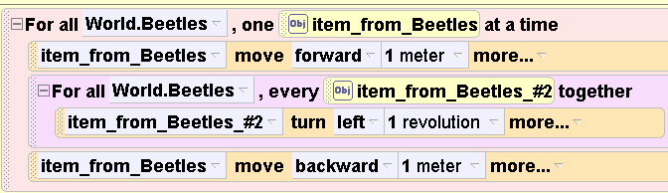
Notes:
The move forward happens only for the ONE beetle whose turn it is. In the outer loop.
And the item to move is item_From_Beetles not item_From_beetles2
Make that change by dragging the move forward above, you have to change item_from_Beetles#2 to item_from_Beetles.
And drag the lower move out the bottom. And demo the fixed code.

Slide 11
There are 4 beetles, how many times is this instruction executed?
4
12
16
48
I don’t know
Notes:
Big Idea: The number of times a statement inside the innermost loop of a set of nested loops “happens” (gets executed) is the product (multiplication) of the number of times the outermost loop runs TIMES the number of times the innermost loop runs.
Correct Answer and Why:
C – 4 beetles in order, and for each of them 4 beetles spin. If you play the demo again slowly, you can see that 4 turns happen (each beetle turns, that’s 4 turn instructions, one per beetle) for each “outer loop” time that one beetle is moved forward
Why Might Students Pick Other Answers/What Sort of Questions Might Be Asked:
A) They will THINK it’s 4, since the “do all together” makes it look like once – but it’s actually one instruction for each of the 4 beetle. That is, the turn tile actually executes 4 times (once for each beetle) during ONE execution of an outer loop… it doesn’t magically make all 4 beetles turn with that one tile.
B and C don’t have a particular rationale…

Slide 12
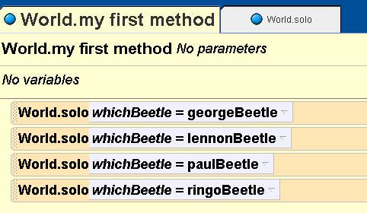
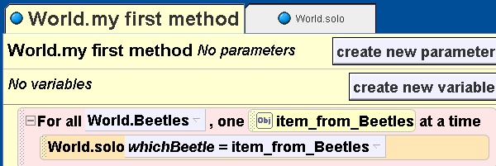
Parameters to methods:
We can do better now!
Notes:
Back when we first learned about methods and parameters, we said they were useful because we could call a method multiple times and change how it behaved based on the parameter value. But, back then, we only knew how to call methods on specific objects. In this case each beetle. NOW we’ve learned another form of ABSTRACTION that is useful for making computers do more work for even less work on the part of the programmer (how much code you have to write). In this case the abstraction is to group objects we want to treat the same way into a LIST, (called an array in some programming languages). Then we have computing instructions (specialized loops) which can automatically “loop over” each element/object in the list.

Slide 13
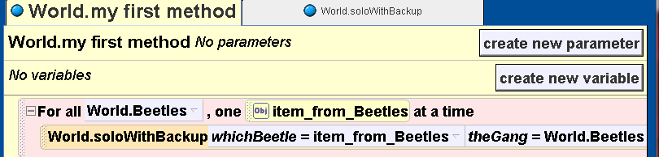
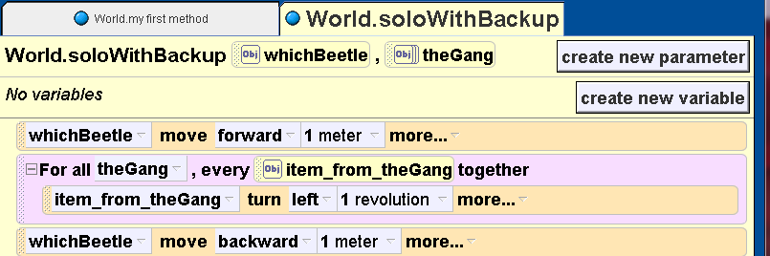
How would we do our “new” solo (with backup)

Slide 14
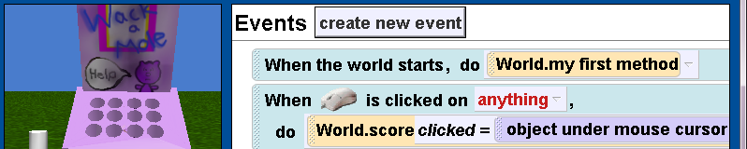
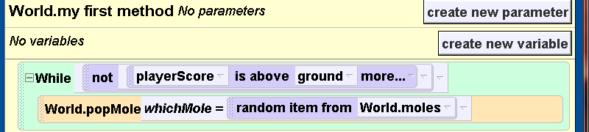
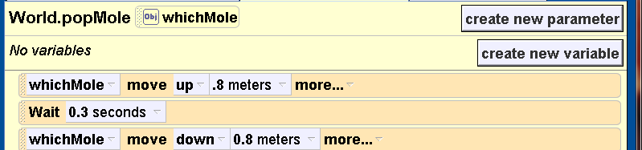
Chapter 9-2 Search
Notes:
Review how it works:
-List of moles (World.moles)
-myfirstMethod – keeps making rnadom moles pop up as long as playerScore cylinder is not above ground…
What about when you click on something?
See next question…

Slide 15
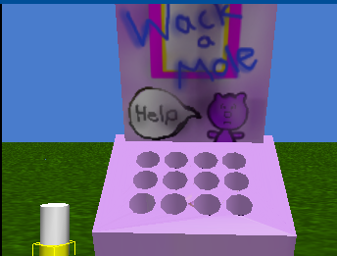
Scoring Review: 2- Cylinder Method
  Start world with yellow cylinder moved down from surface height meters (so it is just below the ground)
  Every time “score” increases, move the yellow cylinder up some amount
  Game is “won” when cylinder is at or above the ground level

Slide 16
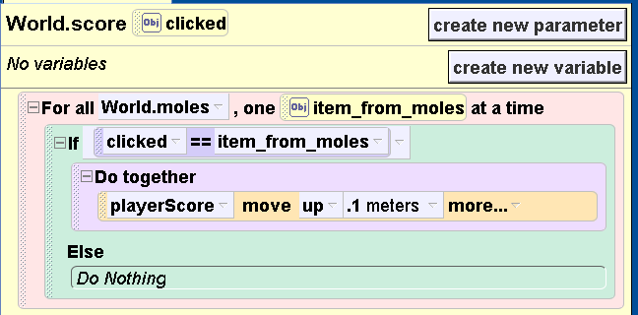
How many times does the if-statement evaluate to true for one call to score?
(one click)
0 times B) 1 time C) more than 1 time
D) A or B E) A or B or C
Notes:
Big Idea: Only one object can be the one “clicked on” at any given time.
Correct Answer and Why:
D either
0 times (you didn’t click on a mole at all – maybe you clicked on the background – that is you missed)
Or
1 times (you clicked on a mole – you can’t click on more than one mole at once)
Remember from the homework that score is called on the event of clicking on an object, and the object that was clicked on is passed as the parameter to the score method.
So there are two possible outcomes, either that the thing clicked on wasn’t ANY of the items in the mole list, or it was ONE of the items in the mole list. This loop over all the moles checks each one to see if it was the object just clicked on (e.g, the parameter clicked).
Why Might Students Pick Other Answers/What Sort of Questions Might Be Asked:
B) Students might think of only the “expected” case, that the user successfully clicked on one of the moles. So they would pick 1 imagining that score is only called when the score should increase. However, the way the book set this up is that the method score is called when anything is clicked on. This could be the game “board” (purple thing) if the user misses. In that case the answer would be 0. (A).
C) It is not possible to click on more than one thing at a time (in this case, the moles are set up so that they are never on top of each other, however, one could imagine placing 2 moles on top of each other in a world. Advanced idea: One objet MUST be “on top” of the other. There will be only one thing that is determined to be clicked upon. I don’t know how Alice decides this if they are “exactly centered” – e.g., you did a move to from one object to the next. Probably students could desing an experiment to figure it out).

Slide 17
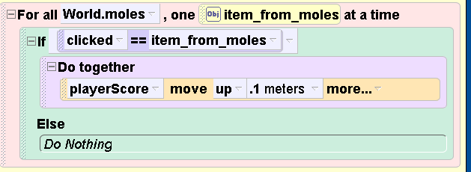
How many times does the if-statement evaluate to true for one game?
0 times
1 time
10 times
Cylinder height / .1 meters times
I don’t know
Notes:
Big Idea: Now we are asking about one GAME not one call to the method score. This is the same code as before, the number of times it will evaluate to true depends on how many times you have to click on a mole in order to win. The big idea here is ALSO the difference between one possible instantiation (e.g. given a specific height of a cylinder) and a more generally correct answer (true no matter the height of the cylinder).
Correct Answer and Why:
D -- It depends on the height of the cylinder – and how much you make it move “up” each time.
If it were 1 meter high (which it is in our example, I think) and it moved up .1 meters at a time, then it’s C. But that’s the great thing about answer D – it’s right no matter what the height of the cylinder is
Why Might Students Pick Other Answers/What Sort of Questions Might Be Asked:
A and B could be chosen if they don’t get the difference between one call to score and that “score” will be called many times in the “game” – once for each time you click on something.
C is the likely common mistake, since students may assume (as it was in the book) that the cylinder is 1 meter tall. In that SPECIFIC design, then the answer 10 is correct. But it is not the MOST correct answer, as in computing we always want to consider not just how code works in ONE specific case, but how it will work in a variety of possible cases. Code that works for only one case (one input, one size of cylinder, one option in a game, one amount to withdraw from your bank account), is not very interesting. It doesn’t really help solve problems more generally

Slide 18
Why do we care?
On an exam…
  Tells us if you understand how the code is working to “make things happen” (like keep score in the game)
In real life…
  When you are exploring trying to figure out why the computer isn’t giving an expected answer it helps to
    Track down what happens when certain other things happen
    See if some condition is set (wrong?) so that something
      Never happens?
      Always happens?
      Happens some number of times?

Slide 19
Debug!
The way the game is set up, not all the moles are set “down into” the whackAMoleBooth equally.
Note: mole6 is “further down” than the others.
Does this have any effect?

Slide 20
Does the position of mole6 have any effect?
No, the game plays correctly
Yes, mole6 is never called to move up
Yes, there’s sometimes a longer delay between moles poping up
Yes, I have another explanation

Slide 21
Midterm Review: Q7
Most missed: Design
Assume we have the method call

Slide 22
This code is a bad design because it unnecessarily passes the oneThing parameter.
This code is a bad design because it unnecessarily passes the anotherThing parameter.
This code is a good design and works properly when called to move the football above the baseball.
This code is a good design but actually moves the baseball above the football.

Slide 23
Would YOU like to change the world?
If you have done well in CSE3…
And you want to work with high school students…
And you want to be paid…

Slide 24
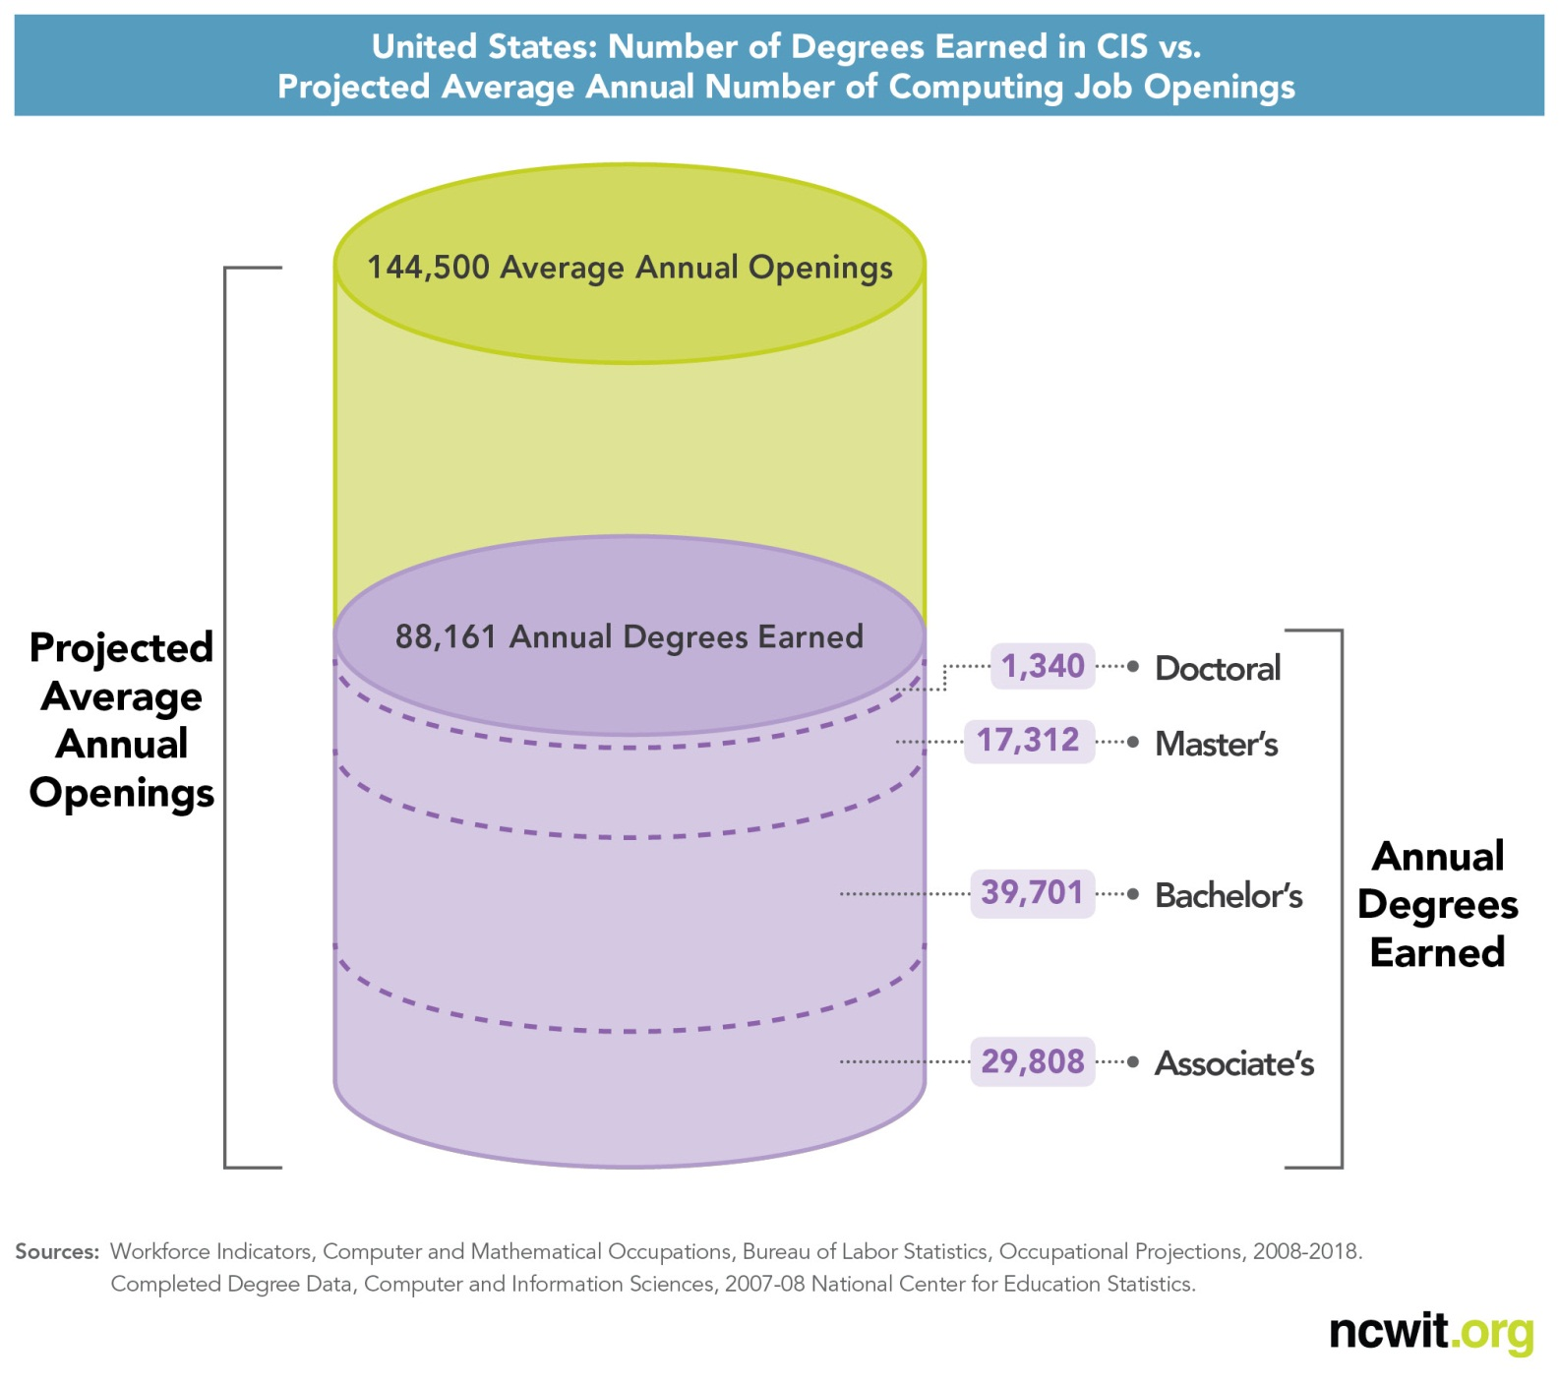
Computing is significantly under producing
postsecondary degrees.
Notes:
BLS, NCES, and SRS data sources; ONLY STEM field where that’s true

Slide 25
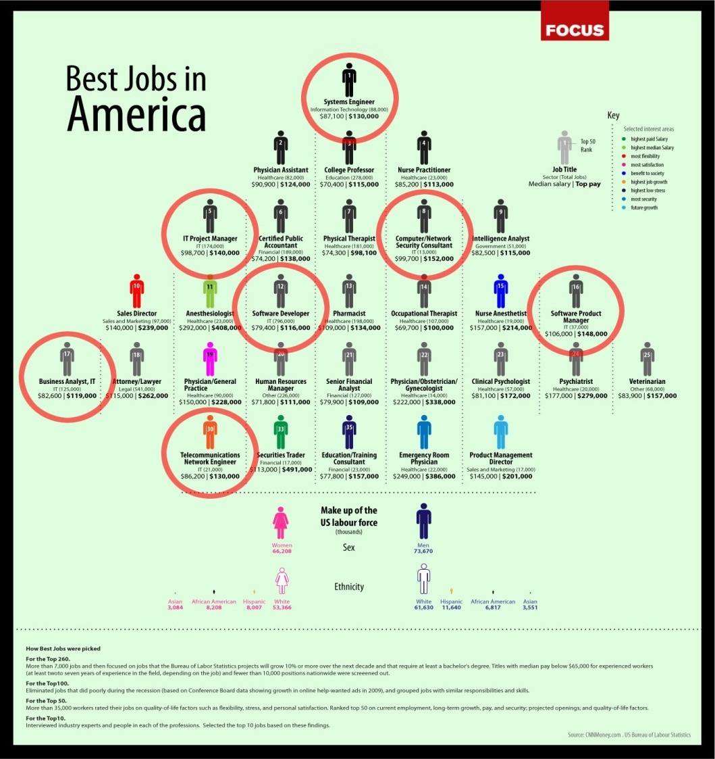
And they’re good jobs.
Slide: CNN Money
Notes:
BLS, NCES, and SRS data sources, CNN Money

Slide 26
Yet student interest in computing is very low.
Percent intending to major in CS
Data source: HERI, Slide: NCWIT

Slide 27
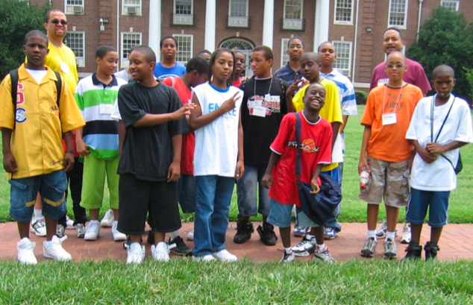
And computing has a long standing underrepresentation of minorities.
URMs receive just:
10.6% of undergrad,
4.8% of master’s, and
3.6% of Ph.D.s
degrees in computing.
—Taulbee Data, 2011
Notes:
We’re also low on Under Represented Minorities but more in line with other sciences.

Slide 28
Forget MAJORS:
Computing is the new literacy.
… the ability to make digital technology do whatever, within the possible one wants it to do -- to bend digital technology to one's needs, purposes, and will, just as in the present we bend words and images.
—Marc Prensky, Edutopia, 1/13/2008
Notes:
of 6321 Bay Area jobs recently listed on Craiglist, 6321 required some form of computer skills.
Animal Control Officer: "To perform this job successfully, an individual should have knowledge of Chameleon database software or become proficient within the first six months from hire date. Basic knowledge or become proficient with Microsoft Office and computer keyboarding skills (data entry).”

Slide 29
Computational Thinking Practices
Analyzing effects of computation
Creating computational artifacts
Using abstractions and models
Analyzing problems and artifacts
Communicating processes and results
Work effectively in teams
csprinciples.org

Slide 30
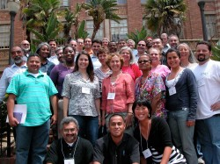
The CS 10K Project aims to transform computing in high school.
Goal: get engaging, rigorous computing curricula into computing courses in 10,000 high schools, taught by 10,000 well-prepared teachers by 2016.
Notes:
There are two courses that have been developed as part of this effort. The first Exploring Computer Science (ECS) is a preAp course and there are a number of other, existing courses that could fill that niche.
CS Principles is the new AP course.
Pictures shows teachers trained on ECS in LA.

Slide 31
The CS 10K Project aims to transform computing in high school.
But we need YOU!
Goal: get engaging, rigorous computing curricula into computing courses in 10,000 high schools, taught by 10,000 well-prepared teachers by 2016.
Notes:
There are two courses that have been developed as part of this effort. The first Exploring Computer Science (ECS) is a preAp course and there are a number of other, existing courses that could fill that niche.
CS Principles is the new AP course.
Pictures shows teachers trained on ECS in LA.

Slide 32
Tutor in (minority serving)
SD high schools
Be “coaches”
  Help in discussion
  Be “lab” tutors
  Help with exploratory homework
Support and train teachers
  Working with teachers NOT in computing
Be a role model!
  Show students that they can do it!
  How rewarding computing is!
In lab next week – we’ll ask you to sign up
  Spring 2012
  2012-2013

