Slide 1
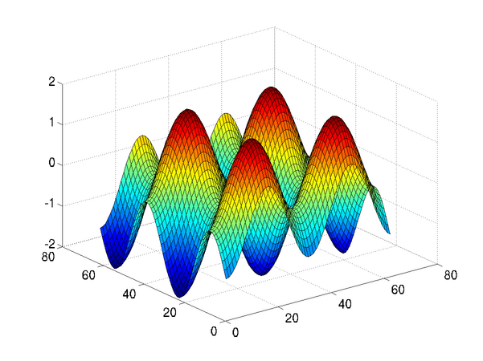
Introduction to Programming in MATLAB
Intro. MATLAB Peer Instruction Lecture Slides by Dr. Cynthia Lee, UCSD is licensed under a Creative Commons Attribution-NonCommercial-ShareAlike 3.0 Unported License. Based on a work at www.peerinstruction4cs.org.

Slide 2
LOOPS: ANIMATION WITH LOOPS

Slide 3
Write a loop that displays all six bird images in order
% script: AnimateBird
bird1 = imread(‘bird1.jpg’);
bird2 = imread(‘bird2.jpg’);
bird3 = imread(‘bird3.jpg’);
bird4 = imread(‘bird4.jpg’);
bird5 = imread(‘bird5.jpg’);
bird6 = imread(‘bird6.jpg’);
birds = cat(4,bird1,bird2,bird3,bird4,bird5,bird6);
for i = 1:6
imshow(birds(:,:,:,i));
drawnow;
end
Notes:
Explain that the cat combines the matrices in the FOURTH dimension (they are already 3-dimensional). So just as we combine 3 layers and interpret that as one image, here we combine 6 full RGB images and we will interpret these as frames of an animation. So the dimensions are:
Row
Column
Layer
Frame
For this example, I used this image, broken into 6 equal-size rectangles: https://i.istockimg.com/file_thumbview_approve/9086799/2/stock-illustration-9086799-hawk-flying-animation-sequence.jpg
It is a good idea to add a “pause(.2)” in the loop to prevent the animation from going too fast. This is a good lesson to have MATLAB running and do some live demonstrations. Have the various versions of the code in this and other slides pre-typed in scripts/functions.

Slide 4
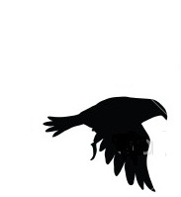
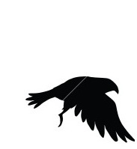
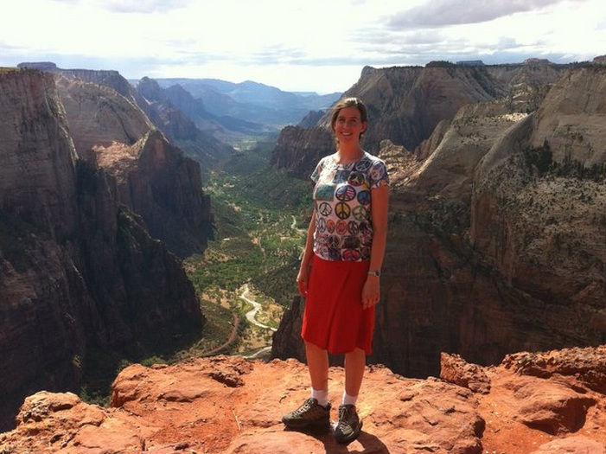
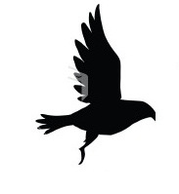
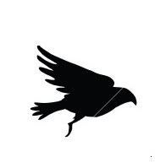
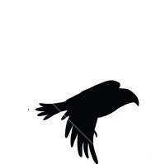
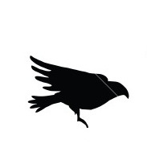
[NOT A SLIDE: raw images]
This is a container for these image files from the example. Please use your own NOT these! And then you would change the text of the slides in this lecture to have filenames that make sense for YOUR example. But these give you an idea of what kind/size images I was using for this example.

Slide 5
Greenscreen a small image (bird) onto a large background (Zion Natl. Park)
function [zion] = PasteBirdonBackground(bird,zion)
% create a white canvas the size of the background
largecanvas = uint8(zeros(size(zion))); % canvas is all black, same size as zion image
largecanvas = 255-largecanvas; % change to all white
% paste the bird into the top left corner of the canvas
??????
% select only the bird part of the canvas
filter = largecanvas(:,:,1) < 30;
filter = cat(3,filter,filter,filter);
% greenscreen
zion(filter) = largecanvas(filter);
end
Notes:
B
For this code example, I use just the first frame of the bird animation frames mentioned in slide 3, and I want to paste it onto the upper left corner of an image of myself in Zion National Park. The idea is to create a photoshop-like effect that there was a bird flying in the canyon during my photo.
Will give an error because it is pasting the (small) bird onto the entire (large) background image. MATLAB requires that when you have an indexed matrix on the left-hand side of an assignment (i.e., writing to a specified region of a matrix), the right-hand side of the assignment must have the same dimensions/size.
Correct.
This does not give the same error as (a) because the LHS is not selecting a region of the matrix, it is just the entire matrix. What will happen is that the largecanvas matrix will simply be entirely obliterated/overwritten by a copy of the bird matrix.
n/a
This is a large block of code to understand in a short time. I try to signal that it is ok to feel a little intimidated at first.

Slide 6
Animate a small image (bird) on a large background (Zion Natl. Park)
% script: AnimateBird
zion = imread(‘zion.jpg’);
bird1 = imread(‘bird1.jpg’);
bird2 = imread(‘bird2.jpg’);
bird3 = imread(‘bird3.jpg’);
bird4 = imread(‘bird4.jpg’);
bird5 = imread(‘bird5.jpg’);
bird6 = imread(‘bird6.jpg’);
birds = cat(4,bird1,bird2,bird3,bird4,bird5,bird6);
for i = 1:6
bird = birds(:,:,:,i);
imshow(PasteBirdonBackground(bird,zion)); % this function on previous slide
drawnow;
end
Notes:
Now the bird flaps in place in the upper left corner of the Zion National Park background.

Slide 7
Greenscreen a small image (bird) across a large background (Zion Natl. Park)
function [zion] = PasteBirdonBackground(bird,zion)
% create a white canvas the size of the background
largecanvas = uint8(zeros(size(zion))); % canvas is all black, same size as zion image
largecanvas = 255-largecanvas; % change to all white
% paste the bird 10 PIXELS TO THE RIGHT OF the top left corner of the canvas
??????
% select only the bird part of the canvas
filter = largeanvas(:,:,1) < 30;
filter = cat(3,filter,filter,filter);
% greenscreen
zion(filter) = largecanvas(filter);
end
Notes:
B
This slide begins to sent the groundwork for moving the bird across the sky so it doesn’t just flap in place. To do that, we will need to offset the placement of the bird by a larger and larger offset each time. I don’t tell the students (yet) that that’s where this is heading. For now, just focus on how the code changes to move the bird slightly.
This would paste the bird to the right AND down. We just want to paste it to the right.
Correct
This would paste the bird down. We want to paste it to the right.

Slide 8
Greenscreen a small image (bird) across a large background (Zion Natl. Park)
function [zion] = PasteBirdonBackground(bird,zion,offset)
% create a white canvas the size of the background
largecanvas = uint8(zeros(size(zion))); % canvas is all black, same size as zion image
largecanvas = 255-largecanvas; % change to all white
% paste the bird “OFFSET” PIXELS TO THE RIGHT OF the top left corner of the canvas
largecanvas(1+offset:size(bird,1)+offset,1:size(bird,2),:) = bird;
% select only the bird part of the canvas
filter = largeanvas(:,:,1) < 30;
filter = cat(3,filter,filter,filter);
% greenscreen
zion(filter) = largecanvas(filter);
end
Add an “offset” argument to the function, so we can decide how far to the right we want to paste.
Notes:
Now show how we can change the hard-coded 10-pixel offset to make this function parameterized on the offset value.

Slide 9
Move a small image (bird) across a large background (Zion Natl. Park)
% script: AnimateBird
zion = imread(‘zion.jpg’);
bird = imread(‘bird1.jpg’);
for offset = ??????
imshow(PasteBirdonBackground(bird,zion,offset));
drawnow;
end
Goal:
Use “offset” version of the function—on previous slide—so we can specify different offsets to make the bird move.
ZION
BIRD
BIRD
Notes:
D
This will only move the bird to the right the width of the bird.
This will cause an error because it will attempt to paste the bird outside the right boundary of the matrix.
Same as (b)
Correct. It moves the bird until the right edge of the bird image reaches the last column of the background image, but no further.
A fun additional thing to think about (that students will often ask about) is how you could have the bird fly off the side of the background rather than stop when it reaches the edge. This would be achieved by some trickier but still very doable loop work that uses matrix indexing to select smaller and smaller parts of the bird image to paste into smaller and smaller regions of the background image. (all but the last column of bird, all but the last two columns of bird, all but the last three columns of bird, etc.)

