Slide 1
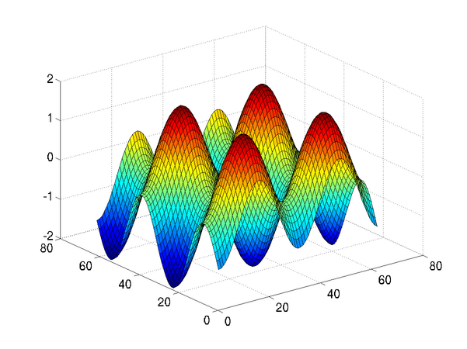
Introduction to Programming in MATLAB
Intro. MATLAB Peer Instruction Lecture Slides by Dr. Cynthia Lee, UCSD is licensed under a Creative Commons Attribution-NonCommercial-ShareAlike 3.0 Unported License. Based on a work at www.peerinstruction4cs.org.

Slide 2
Comparison Operators

Slide 3
What is printed here?
Matrix-to-matrix comparison operators
x = [98 99 96];
y = [96 99 98];
x == y
ans =
1
0 1 0
1 1 1
0
Other/error
Notes:
B
and (d) assume there is just one answer to this question—but instead it returns a vector of pairwise equality results
Correct. 98==96->0, 99==99->1, 96==98->0
98==96 is not true/1

Slide 4
What is printed here?
Matrix-to-matrix comparison operators
x = [98 99 96];
y = [96 99 98];
x <= y
ans =
1
0 1 1
1 0 0
0
Other/error
Notes:
B
and (d) assume there is just one answer to this question—but instead it returns a vector of pairwise equality results
Correct. 98<=96->0, 99<=99->1, 96<=98->1
98<=96 is not true/1

Slide 5
Analyzing compound logical expressions
>> a = 3;
>> b = 4;
>> c = 7;
>> x = (c <= a + b);
>> y = (a ~= a);
>> xor(~(~x & ~y),x)
ans =
What is the result of this code?
1
0
Other/error
Notes:
B
x = 7 <= 3 + 4; -> 1
y = 3 ~= 3; -> 0
xor ( ~(0 & 1),1) -> xor(1,1) -> 0

