Slide 1
Theory of Computation
Theory of Computation Peer Instruction Lecture Slides by Dr. Cynthia Lee, UCSD are licensed under a Creative Commons Attribution-NonCommercial-ShareAlike 3.0 Unported License. Based on a work at www.peerinstruction4cs.org.

Slide 2
Famous People: Alan Turing
“Father of Computer Science”

Slide 3
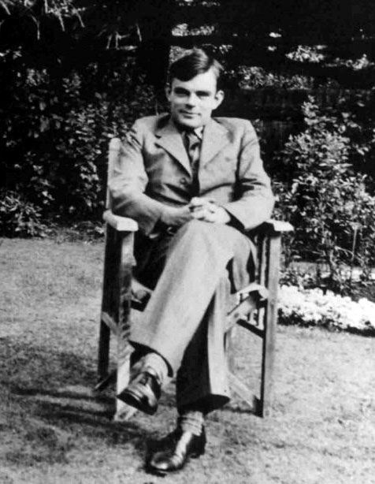
Famous People: Alan Turing
“Father of Computer Science”
Born in England in 1912
Studied at University of Cambridge (UK)
Contributions to:
Computer Science
Logic
Artificial Intelligence
Cryptography

Slide 4
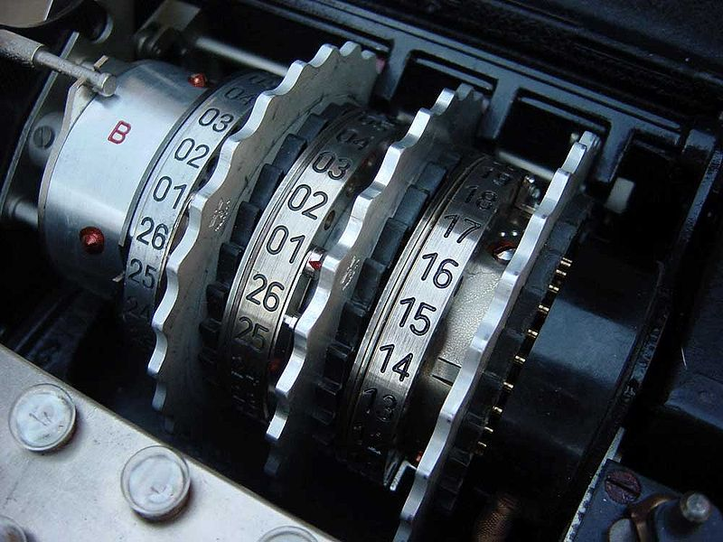
During WWII
German “Enigma” machine was used to send sophisticated encrypted messages
Cracking the Enigma code a major factor in course of the war
First cracked by Polish investigators, who shared techniques with England
Turing and others devised further ways of detecting configurations
Allowed England to know which cities were going to be bombed, U-boat whereabouts, etc
Enigma configuration rotors

Slide 5
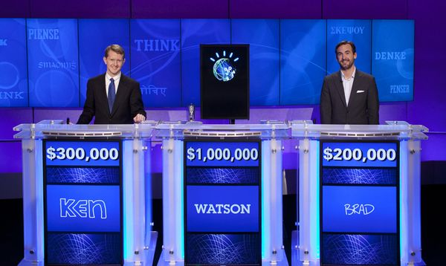
Artificial Intelligence
In this Jeopardy! challenge, the identities were not hidden, so it was not a Turing Test format. But it was a remarkable display of the kind of power that Turing predicted machines could have.
How will we know if/ when computers have achieved enough sophistication to be called intelligent?
Alan Turing proposed the “Turing Test”
A human tester chats with a human and computer
Can the tester reliably identify which is which?

Slide 6
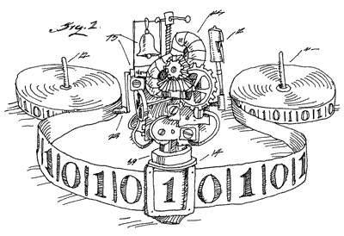
Current Events
Turing’s Three Major Contributions in this Course
Turing Machine design
Talk about this starting today (!!)
Church-Turing thesis
Halting problem undecidability
Talk about these over the next two weeks
In 2009, British government issued a formal apology for its persecution of Turing, which may have led to his suicide at just 41 years old
Alan Turing was a gay man, and homosexuality was crime in England at that time
Government forced him to undergo “treatments” with terrible side effects

Slide 7
Turing Machines
At last we reach:

Slide 8
Turing Machine Model

Slide 9
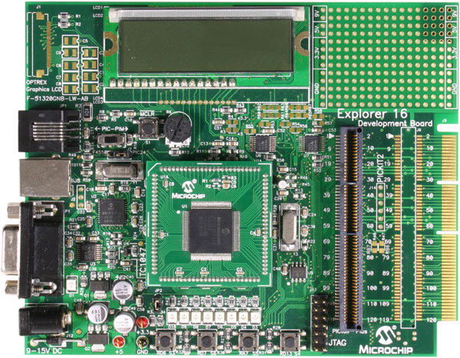
Why do we care about Turing Machines?
All modern computers follow the Turing Machine model
CPU = TM control
Memory = TM tape
This division seems obvious now, but is the core of Turing’s model
Our memory isn’t infinite ☹
Theoretical analysis of TMs answers the question: what kinds of problems could we solve (or can’t we solve), if we didn’t have to worry about memory limitations (sometimes with “cloud” computing it feels like we’re almost to that point!)
“Memory” can include all levels of the memory hierarchy (more about this in CSE 141): RAM, disk, etc

Slide 10
Turing Machine Formal Description
In the TM transition function δ: QxΓ -> QxΓx{L,R}, in other words, a given input of the transition function is:
A current state, a character read, and whether we came from the left or right
A current state, a character read
A current state, a character to write
A destination state, a character read
None of the above or more than one of the above
Notes:
(B)
On some level, this is just a review of mathematical function notation. Because we are only interested in INPUT, we only look on the LHS of the arrow operator. There are two things there, so that rules out (A).

Slide 11
Turing Machine Formal Description
In the TM transition function δ: QxΓ -> QxΓx{L,R}, in other words, a given output of the transition function is:
A current state, a character read, and whether we came from the left or right
A current state, a character to write, and whether we should next go left or right
A destination state, a character read, and whether we should write ‘L’ or ‘R’
A destination state, a character to write, and whether we should next go left or right
None of the above or more than one of the above
Notes:
(D)

Slide 12
Executing a Transition, “yields”
Suppose we have at TM s.t. Γ={a,b,c,d,_}, Q = {q_{x} | 1≤x≤10} U {q_{acc},q_{rej}}, and the transition function includes rules δ(q₁,a) = (q₃,b,R) and δ(q₁,b) = (q₃,a,L). We also have strings x,y in Γ*. Which configuration does the current configuration, xbq₁ay, yield?
xq₃bay
xbbq₃y
xbaq₃by
xq₃aay
None of the above or more than one of the above
Notes:
(B)
This helps students understand the inline notation where the q_3 being to the left of a character actually means it is “over” that character, if we had a more visually intuitive notation system.

Slide 13
Executing a Transition, “yields”
Suppose we have at TM s.t. Γ={0,1,_}, Q = {q_{x} | 1≤x≤7} U {q_{acc},q_{rej}}, and the transition function includes rules δ(q₂,1) = (q₁,0,R) and δ(q₂,0) = (q₁,1,L). We also have strings x,y in Γ*. Which configuration does the current configuration, x0q₂1y, yield?
xq₁01y
x01q₁y
x00q₁y
xq₁11y
None of the above or more than one of the above
Notes:
(C) This question is isomorphic to the previous question.

Slide 14
Executing a Transition, “yields”
Suppose we have at TM s.t. Γ={a,b,c,d,_}, Q = {q₁, q₂, q₃, q₄,q_{acc},q_{rej}}, and the transition function includes rules δ(q₂,c) = (q₃,d,R) and δ(q₂,d) = (q₃,c,L). We also have strings u,v,x,y in Γ*. Which configuration does the current configuration, xcq₂dy, yield?
xq₃ddy
xcdq₃y
xq₃ccy
xq₃ccdy
None of the above or more than one of the above
Notes:
(C)

Slide 15
More Transition Function
(a) TRUE
(b) FALSE
x0q_{rej}11y yields x01q₁1y can never happen in any Turing Machine
Notes:
TRUE, it cannot happen because qrej takes effect immediately and the machine halts.

