Slide 1
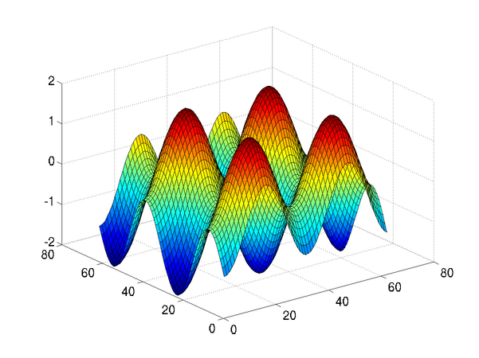
Introduction to Programming in MATLAB
Intro. MATLAB Peer Instruction Lecture Slides by Dr. Cynthia Lee, UCSD is licensed under a Creative Commons Attribution-NonCommercial-ShareAlike 3.0 Unported License. Based on a work at www.peerinstruction4cs.org.

Slide 2
How Images Are Stored in the Computer
Taking another peek inside to see the illusion

Slide 3
How Computers Store Images
Computers store images as a mosaic of tiny squares*
Each square is one color
No varying color within a square
Square is called a pixel
Like the ancient art form of tile mosaics, or the melting beads kits kids play with today
* Vector graphics are a somewhat different method of storing images;, but we’ll set those aside for now—and even vector images are displayed as a mosaic of pixels.

Slide 4
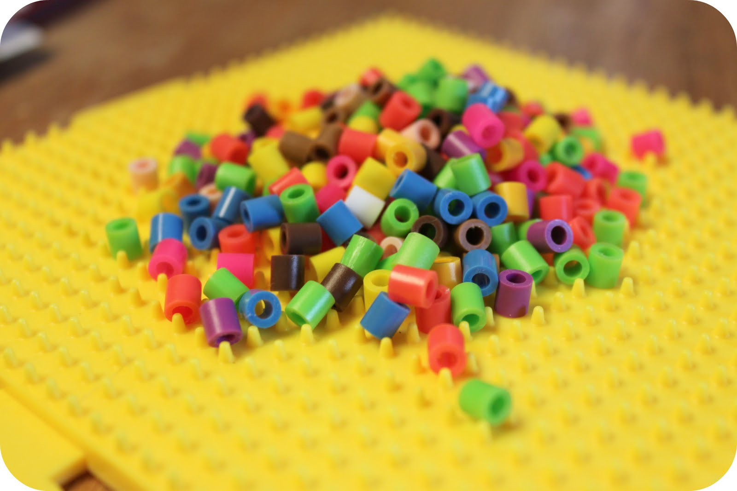
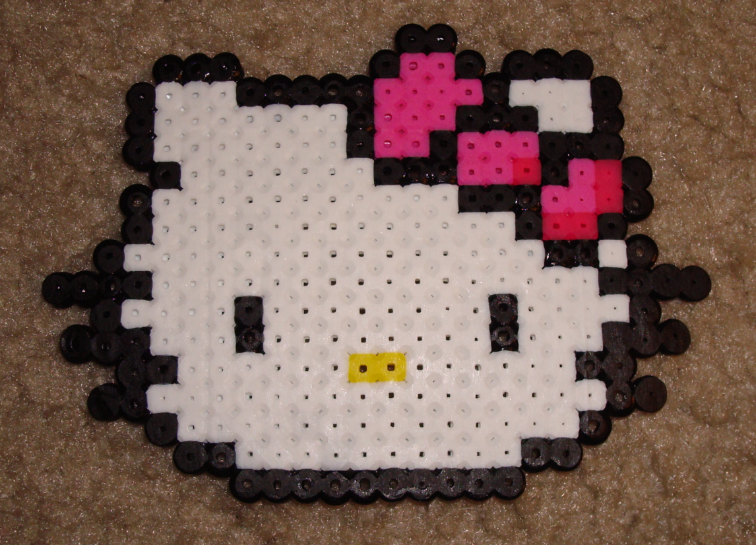
How Computers Store Images

Slide 5
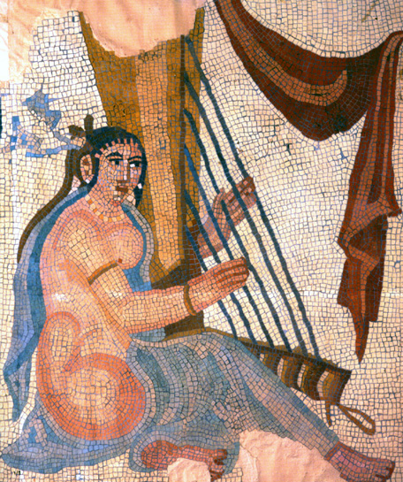
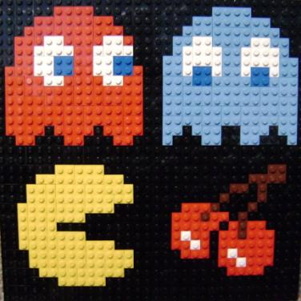
Square Pixels Are Inherently Rough/Jagged
Hard to make smooth edges and curves with only square tiles!
The more&smaller tiles you use, the smoother (less pixelated) the image

Slide 6
To a computer, images are a matrix of pixels
But remember: to a computer, a color is made of three numbers: a value each for Red, Green, Blue
Notes:
Might note for students that the black lines do not appear between actual pixels on a computer screen.

Slide 7
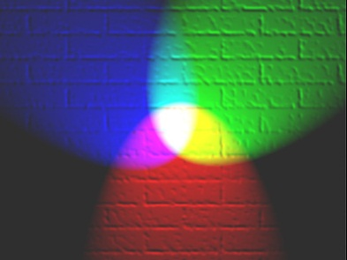
In MATLAB, RGB images are matrices of size [Height X Width X 3]
191 | 100 | 0 | 99 | 0 | 0 | 0 | 30 | 40 | 66
99 | 99 | 99 | 99 | 99 | 99 | 0 | 30 | 10 | 10
255 | 255 | 0 | 255 | 255 | 0 | 0 |  | 10 | 10
 |  |  |  |  |  | 99 | 100 | 0 | 0
 |  |  |  |  |  | 99 | 100 | 0 | 0
 |  |  | 99 | 100 | 99 | 99 | 99 | 99 | 0
191 | 245 | 250 | 99 | 192 | 0 | 0 | 245 | 250 | 0
99 | 100 | 0 | 0 | 99 | 99 | 0 |  | 250 | 250
99 | 99 | 99 | 0 | 255 | 0 | 99 | 100 | 0 | 0
255 | 255 | 0 | 0 |  |  | 99 | 99 | 99 | 0
 |  |  |  |  |  | 255 | 255 | 0 | 0
 |  |  |  |  | 99 | 99 | 100 | 0 | 0
191 | 0 | 0 | 0 | 255 | 255 | 255 | 255 | 255 | 156
0 | 0 | 0 | 0 | 0 | 0 | 0 | 255 | 255 | 255
99 | 100 | 99 | 100 | 0 | 0 | 0 | 0 | 0 | 255
99 | 99 | 99 | 99 | 99 | 0 | 100 | 0 | 0 | 255
0 | 0 | 255 | 255 | 0 | 0 | 0 | 0 | 255 | 255
0 | 0 | 0 | 0 | 0 | 0 | 0 | 0 | 0 | 0
Note: only the circled numbers are correct for the colors shown, the rest are made up.

Slide 8
Indexing an Image Matrix
What color is at image(4,3,:)?
b) c) d) e) Other
Notes:
B
Catches common error seen in students trained in other programming languages that 0-index their vectors/matrices (e.g. Java, C++). Even for students with no prior programming experience, it is not uncommon to see a counting error of counting 1-2-3 as student moves right through the columns, with the count starting with the first move right (column 2).
Correct
Confusing row/col indices. (c) is the result of image(3,4,:) not image(4,3,:)
Arbitrary distractor

Slide 9
Indexing an Image Matrix
How can we describe the golden column?
image(8,:, )
image(:,8, )
image(8,:,:)
image(:,8,:) e) Other/none/more than one
Notes:
D
and (b) can’t just leave place blank if you don’t want to specify—must use colon or specify
(a) and (c) switches row/col index

Slide 10
Indexing an Image Matrix
How can we describe the amount of blue in the circled pixel?
image(6,4,:)
image(6,4,3)
image(end,4,3)
image(end,4,end) e) Other/none/more than one
Notes:
E (more than one)
Selects all 3 RGB layers not just blue
Correct
Correct (“end” = 6 in this case)
Correct (first “end” = 6 and second “end” = 3 in this case)
CORRECT: more than one

