Slide 1
Theory of Computation
Theory of Computation Peer Instruction Lecture Slides by Dr. Cynthia Lee, UCSD are licensed under a Creative Commons Attribution-NonCommercial-ShareAlike 3.0 Unported License. Based on a work at www.peerinstruction4cs.org.

Slide 2
Non-Regular Languages
On beyond Regular!

Slide 3
Next we’ll be talking about non-Regular Languages
All part of becoming intimately familiar with the boundaries that define these language classes
Notes:
The (terrible) graphics in this sequence of slides is meant to illustrate what I draw on the slides in-class. If you are using ink, delete the graphics and draw them yourself in class “live.” (it’s ok for ink to look messy when doing it live) If not, I would suggest making a neater version of this using MSPowerPoint drawing tools rather than ink. Of course, you can also just use this as-is.

Slide 4
Next we’ll be talking about non-Regular Languages
All part of becoming intimately familiar with the boundaries that define these language classes
Closure properties are one way of doing exploring transformations that keep us in the boundaries of the class of Regular Languages

Slide 5
Next we’ll be talking about non-Regular Languages
All part of becoming intimately familiar with the boundaries that define these language classes
Closure properties are one way of doing exploring transformations that keep us in the boundaries of the class of Regular Languages
Now we’re bursting through the boundary! It’s an exciting day!!

Slide 6
Pigeonhole Principle
For the birds

Slide 7
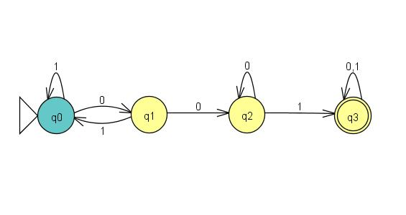
What is the longest string this DFA can accept without visiting any state more than once?
1
3
4
5
None of the above
Notes:
(B)
String 001 can be produced by visiting states q0, q1, q2, q3. Students may confuse the number of states (4) with the length of the longest string (3), a fencepost problem error.

Slide 8
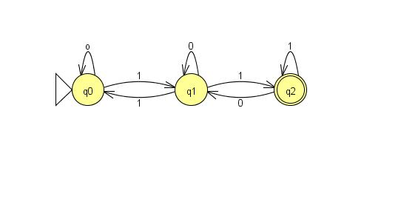
What is the longest string this DFA can accept without visiting any state more than once?
1
2
3
4
None of the above
Notes:
(B)

Slide 9
Generalizing:
Given a string s and a DFA M that accepts s:
If |s| > |Q|, then when M processes s, it must visit one (or more) state(s) more than once
For a second, let’s just consider one state (q_{x}) being twice visited
Let y be the substring of s that is read between the first and second times the twice-visited state (q_{x}) is visited
It must be the case that y could appear repeatedly in s:
s = [first part of s]y[last part of s] is accepted by the DFA, then also possible in this DFA:
[first part of s]yy[last part of s]
[first part of s]yyyyyyyyyyy[last part of s]
[first part of s][last part of s]
WHY?? Discuss in your group
Notes:
For the group discussions, suggest students do the following:
Draw an example DFA
Make a sample string s and label the parts of s: [first part of s] y [last part of s]
Show in your DFA where y is processed

Slide 10
The Pumping Lemma Proving a Language is Not Regular
On beyond Regular!

Slide 11
The Pumping Lemma: A One-Act Play
Your Script
Pumping Lemma’s Script
“I’m giving you a language L.”
“Uh…sure…let’s just say it’s Regular.”
“Excellent. I’m giving you this string s that I made using your p. It is in L and |s| >= p. I think you’ll really like it.”
“Hm. I followed your directions for xyz, but when I [copy y N times or delete y], the new string is NOT is L! What happened to your 100% Warranty??!”
“Is L Regular? In this shop I only work on Regular Languages.”
“Good. For the Regular language L that you’ve given me, I pick this nice pumping length I call p.”
“Great string, thanks. I’ve cut s up into parts xyz for you. I won’t tell you what they are exactly, but I will say this: |y| > 0 and |xy| <= p. Also, I make you this 100% Lifetime Warranty: you can remove y, or copy it as many times as you like, and the new string will still be in L, I promise!”
“Well, then L wasn’t a Regular Language. Since you lied, the Warranty was void. Thanks for playing.”
Notes:
Have discussion groups of size 4 break into two pairs. Groups of three have one person sit out. Have students pick a role and read the play doing their parts. Explain that this might feel silly, but is not intended for that purpose. Research shows that saying something out loud makes it “stick” better. For Pumping Lemma proofs, it is extremely important that students understand which parts they choose/control, and which parts they do not control/cannot choose. A very common error in Pumping Lemma proofs by students is that they choose a particular value for p, or a particular xyz slicing of the string, and complete the proof for just those particular values. This is of course an erroneous approach. The point of this exercise is to physically embody the two separate roles, and (we hope) permanently etch in the students’ minds which part was their own and which part was read by their partner.

Slide 12
How to use the Pumping Lemma Script to write a Pumping Lemma Proof (1)
Let’s look at the parts of your script:
Picking language L:
Done—given to you in the homework/exam problem
Start the proof:
Proof by contradiction: Assume L is regular
Picking s:
Here you need to get creative
Try several things, remember:
s must be in L
|s| must be >= p (often do this by making some pattern repeat p times, e.g., s = “0^{p}1^{p}” is clearly of length >= p)
Notes:
This how-to guide is so they can see how the somewhat fanciful script maps on to the process of actually writing the proof.

Slide 13
The Pumping Lemma: A One-Act Play
Your Script
Pumping Lemma’s Script
“I’m giving you a language L.”
“Uh…sure…let’s just say it’s Regular.”
“Excellent. I’m giving you this string s that I made using your p. It is in L and |s| >= p. I think you’ll really like it.”
“Hm. I followed your directions for xyz, but when I [copy y N times or delete y], the new string is NOT is L! What happened to your 100% Warranty??!”
“Is L Regular? In this shop I only work on Regular Languages.”
“Thanks. For the language L that you’ve given me, I pick this nice pumping length I call p.”
“Great string, thanks. I’ve cut s up into parts xyz for you. I won’t tell you what they are exactly, but I will say this: |y| > 0 and |xy| <= p. Also, I make you this 100% Lifetime Warranty: you can remove y, or copy it as many times as you like, and the new string will still be in L, I promise!”
“Well, then L wasn’t a Regular Language. Since you lied, the Warranty was void. Thanks for playing.”
Notes:
This version has color-coding to match the how-to guide, so they can see how this somewhat fanciful script maps on to the process of actually writing the proof.

Slide 14
How to use the Pumping Lemma Script to write a Pumping Lemma Proof (2)
Let’s look at the parts of your script:
Picking i (the number of times to copy part y):
For many problems, two main ways to go: i = big: (say, 3 or p), or i = 0 (delete y)
Try both and see if either “breaks” s (makes a string not in L)
If several tries don’t work, you may need to design a different s
End the proof:
Once you find an i/s pair that “breaks” the warranty, this is a contradiction, and so the assumption is false, and L is not Regular. QED.

Slide 15
Pumping Lemma Practice
Thm. L = {O^{n}1^{m}O^{n}| m,n >= 0} is not regular.
Proof (by contradiction):
Assume (towards contradiction) that L is regular. Then the pumping lemma applies to L. Let p be the pumping length. Choose s to be the string _________. The pumping lemma guarantees s can be divided into parts xyz s.t. for any i>=0, xy^{i}z is in L, and that |y|>0 and |xy|<=p. But if we let i = ____, we get the string XXXX, which is not in L, a contradiction. Therefore the assumption is false, and L is not regular. Q.E.D.
s = 00000100000, i = 5
s = 0^{p}10^{p}, i=0
s = (010)^{p}, i=5
None or more than one of the above
I don’t understand this at all
Notes:
(B)
We know that the y portion must lie in the first set of 0’s, because there are p of them and the xy portion is at most length p. So with i=0, we lose one or more 0’s, making them not match the second set of 0’s.
These practice slides are designed to help students see how formulaic Pumping Lemma proofs are. Many students are very intimidated by the “wall of text” of the Pumping Lemma, and reflexively fear that Pumping Lemma proofs are too hard and too complicated. The visual effect of the way these slides are structured is that while there is a great deal of text here, most of it is boilerplate, and completing the proof really comes down to the selection of s and i—very manageable!!
The other thing students should take away from these slides is a mental checklist to apply to s/i candidates they might come up with in writing their own proofs. (1) Does my string s depend on p? (2) Is my string s in the language L? (3) Is the pumped string *not* in the language L? etc.

Slide 16
Pumping Lemma Practice
Thm. L = {O^{n}1^{n} | n >= 0} is not regular.
Proof (by contradiction):
Assume (towards contradiction) that L is regular. Then the pumping lemma applies to L. Let p be the pumping length. Choose s to be the string _________. The pumping lemma guarantees s can be divided into parts xyz s.t. for any i>=0, xy^{i}z is in L, and that |y|>0 and |xy|<=p. But if we let i = ____, we get the string XXXX, which is not in L, a contradiction. Therefore the assumption is false, and L is not regular. Q.E.D.
s = 010101, i = 0
s = 000000111111, i=6
s = 0^{p}1^{p}, i=1
s = 0^{i}1^{i}, i=5
None or more than one of the above
Notes:
(C)
s is not in L
s is in L, but does not depend on p, so if p is larger than 12, this s does not meet the criteria that |s| >= p.
Correct
Can’t use i in the string s

Slide 17
Pumping Lemma Practice
Thm. L = {ww_{r} | w_{r} is the reverse of w} is not regular.
Proof (by contradiction):
Assume (towards contradiction) that L is regular. Then the pumping lemma applies to L. Let p be the pumping length. Choose s to be the string _________. The pumping lemma guarantees s can be divided into parts xyz s.t. for any i>=0, xy^{i}z is in L, and that |y|>0 and |xy|<=p. But if we let i = ____, we get the string XXXX, which is not in L, a contradiction. Therefore the assumption is false, and L is not regular. Q.E.D.
s = 000111111000, i=6
s = 0^{p}0^{p}, i=2
s = 0^{p}110^{p}, i = 2
None or more than one of the above
Notes:
(C)

Slide 18
Modeling Grammatical Understanding
Grammar intuition
Notes:
This is intended to show students the miraculously counter-intuitive idea that they have mastered grammar rules they are not conscious of. They haven’t simply memorized correct and incorrect examples (because they probably haven’t seen these particular word combinations before); instead, they have built in generalizable rules.

Slide 19
Vote your first gut instinct!
Which is the correct order?
a small Canadian thin lady
a Canadian small thin lady
a small thin Canadian lady
a thin small Canadian lady
Credits: Quiz questions taken from: http://web2.uvcs.uvic.ca/elc/studyzone/410/grammar/adjord.htm
Notes:
Most native English speakers will say (C)
(I do NOT do group discussion on these)

Slide 20
Vote your first gut instinct!
Which is the correct order?
a carving steel new knife
a new steel carving knife
a steel new carving knife
a new carving steel knife
Credits: Quiz questions taken from: http://web2.uvcs.uvic.ca/elc/studyzone/410/grammar/adjord.htm
Notes:
Most native English speakers will say (B)

Slide 21
Vote your first gut instinct!
Which is the correct order?
a beautiful blue sailing boat
a blue beautiful sailing boat
a sailing beautiful blue boat
a blue sailing beautiful boat
Credits: Quiz questions taken from: http://web2.uvcs.uvic.ca/elc/studyzone/410/grammar/adjord.htm
Notes:
Most native English speakers will say (A)

Slide 22
Adjective Categories and Ordering
When using more than one adjective, must be placed in this order
Opinion: silly, beautiful, horrible, difficult
Size: large, tiny, enormous, little
Age: ancient, new, young, old
Shape: square, round, flat, rectangular
Color: blue, pink, reddish, grey
Origin: French, lunar, American, eastern, Greek
Material: wooden, metal, cotton, paper
Purpose: sleeping (as in "sleeping bag"), roasting (as in "roasting tin")
Credits: http://web2.uvcs.uvic.ca/elc/studyzone/410/grammar/adjord.htm
Notes:
This is what linguists think the generalizable rule is for these examples. These can be further summarized as a sense that the more “inherent” an adjective category is, the closer adjectives in that category should be placed to the noun. So, for whatever reason, we have decided that the material an object is made of is more “inherent” than its color.

Slide 23
Did you know you knew that??
Could you have written down those rules?
Then how did you apply them?
Did anyone ever explicitly teach you how to correctly structure multi-adjective clauses using that list?
Our subconscious collection of language rules is fantastically complex, detailed, rich
Linguists, Psychologists and Anthropologists have long been amazed and puzzled by the human capacity for acquiring language
Context-free grammars are one way that scholars have tried to model how language, and our brain’s models of language, might be structured
Key concept: representing and generating infinite complexity, with just a few simple rules (not unlike fractals)

Slide 24
Context-Free Grammars CFGs
Back to your [English/Spanish/French/…] class

Slide 25
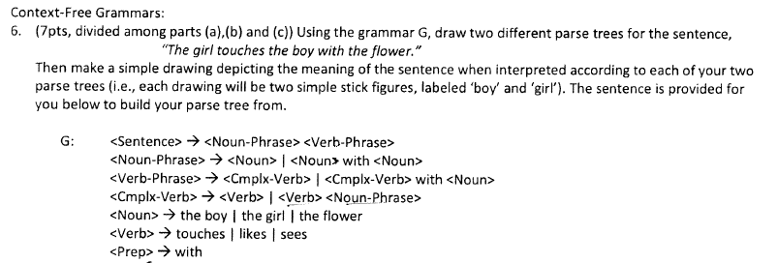
Example Problem
S -> NP VP
NP -> CN | CN PP
VP -> CV | CV PP
PP -> P CN
CN -> A N
CV -> V | V NP
A -> a | the
N -> boy | girl | flower
V -> touches | likes | sees
P -> with
S = Sentence
NP = Noun-Phrase
VP = Verb-Phrase
PP = Prep-Phrase
CN = Complex-Noun
CV = Complex-Verb
A = Article
N = Noun
V = Verb
P = Preposition

Slide 26
Parse Tree
S -> NP VP
NP -> CN | CN PP
VP -> CV | CV PP
PP -> P CN
CN -> A N
CV -> V | V NP
A -> a | the
N -> boy | girl | flower
V -> touches | likes | sees
P -> with
“The girl touches the boy with the flower.”
(a) (b)
Notes:
Draw a parse tree for this sentence based on the grammar. Involve student suggestions/assistance if desired. Then have all the students vote on whether the interpretation of the sentence corresponds to drawing (a) or drawing (b), and discuss in their groups as usual.

Slide 27
Parse Tree 2
S -> NP VP
NP -> CN | CN PP
VP -> CV | CV PP
PP -> P CN
CN -> A N
CV -> V | V NP
A -> a | the
N -> boy | girl | flower
V -> touches | likes | sees
P -> with
“The girl touches the boy with the flower.”
(a) (b)
Notes:
Draw the other parse tree and talk about why it matches to a different drawing from the one on the last slide.

Slide 28
Ambiguity

Slide 29
Modifying a Grammar
S -> NP VP
NP -> CN | CN PP
VP -> CV | CV PP
PP -> P CN
CN -> A N
CV -> V | V NP
A -> a | the
N -> boy | girl | flower
V -> touches | likes | sees
P -> with
What if we want to add support for conjunctions?
Words such as "and" "or" "but" and "yet"
Connect two thoughts (clauses) into one sentence
Each clause could stand on its own as a complete sentence:
The midterm is coming up soon and I hope I will be ready.
This homework problem is hard but I know I can do it!

Slide 30
Adding Support for Conjunctions
(A)
S -> JP J JP | NP VP
JP -> NP VP
NP -> CN | CN PP
VP -> CV | CV PP
PP -> P CN
CN -> A N
CV -> V | V NP
A -> a | the
N -> boy | girl | flower
V -> touches | likes | sees
P -> with
J -> but | and | yet
(B)
S -> NP VP J NP VP | NP VP
NP -> CN | CN PP
VP -> CV | CV PP
PP -> P CN
CN -> A N
CV -> V | V NP
A -> a | the
N -> boy | girl | flower
V -> touches | likes | sees
P -> with
J -> but | and | yet
(C)
S -> S J S | NP VP
NP -> CN | CN PP
VP -> CV | CV PP
PP -> P CN
CN -> A N
CV -> V | V NP
A -> a | the
N -> boy | girl | flower
V -> touches | likes | sees
P -> with
J -> but | and | yet
Notes:
An argument could be made for all of these options. Some are more elegant, some allow sentences you might want to disallow, and vice versa. For example, (C) allows long run-on sentences constructed with many conjunctions. That might be a bug or a feature, depending on your opinion about what makes sense grammatically. This is a fun one to see what students come up with in their group discussions.

Slide 31
Adding Support for Plural Noun Objects
“The girl touches the boy and the flower”
S -> NP VP
NP -> CN | CN PP
VP -> CV | CV PP
PP -> P CN
CN -> A N
CV -> V | V NP | V PN
PN -> CN and PN | CN and CN
A -> a | the
N -> boy | girl | flower
V -> touches | likes | sees
P -> with

