Slide 1
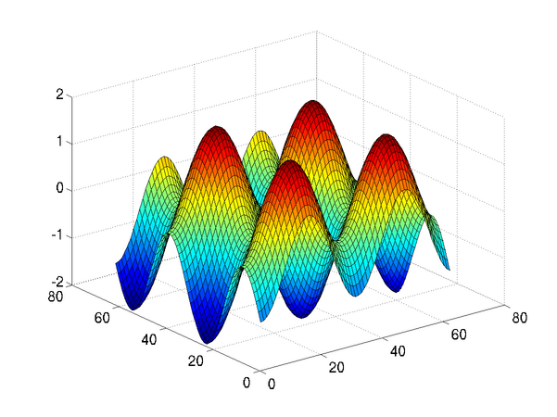
Introduction to Programming in MATLAB
Intro. MATLAB Peer Instruction Lecture Slides by Dr. Cynthia Lee, UCSD is licensed under a Creative Commons Attribution-NonCommercial-ShareAlike 3.0 Unported License. Based on a work at www.peerinstruction4cs.org.

Slide 2
Expressions
Express yourself

Slide 3
Which expression does NOT give the same answer as the others?
a * b + c * d
(a * b + c * d)
a * (b + c) * d
(a * b) + (c * d)
None or more than one of the above
Notes:
C
The distractor choices all rely on (or replicate) the default order of operations.

Slide 4
Assignments
(not the homework kind)

Slide 5
Which of the following is the result of running this code:
>> a = 6;
>> b = 3;
>> a = b;
>> b = 5;
The value of the variable a is the character ‘b’, and the value of variable b is 5
The value of variable a is 5 and the value of variable b is 5
The value of variable a is 3 and the value of variable b is 5
MATLAB will give an error
None or more than one of the above
Notes:
C
Catches common confusion of variable name b vs string literal ‘b’
Catches common misconception that the assignment in the third line of code creates some kind of association or alias between a and b such that the re-assignment of b on the fourth line of code also affects variable a. This can happen when students are used to mathematics system of equations, all of which are operative simultaneously, as opposed to computer program code that is executed as a sequence of instructions.
(correct)
Catches misconception that third line of code is not valid because b is not in quotes as a string literal.

Slide 6
What is a variable? Variables are like labeled boxes
Assignment (=) puts something in the box
Assigning one variable to another copies what was in one box and places a copy in the other box
Always copies values from right to left

Slide 7
Which of the following is the result of running this code:
>> a = 6;
>> b = 3;
>> a = b;
>> b = a;
The value of variable b is the character ‘a’ and the value of the variable a is the character ‘b’
The value of variable a is 6 and the value of variable b is 3
The value of variable a is 3 and the value of variable b is 6
MATLAB will give an error
None or more than one of the above

Slide 8
Colors in the Computer
Taking a peek behind the wizard’s curtain

Slide 9
To a computer, everything is numbers
Everything.
What we perceive | What it is to the computer
Numbers | Numbers
Words | Numbers
Colors | Numbers
Pictures | Numbers
Sounds | Numbers
Video | Numbers
Pushing buttons on the keyboard or mouse | Numbers
Facebook status update | Numbers

Slide 10
Colors in the computer
The RGB Color scheme is a way for the computer to represent colors as numbers
RGB stands for Red, Green, and Blue
All colors in the computer are made by combining different amounts of red, green and blue
In other words, each color is represented by a vector of three numbers:
1st number says how much red
2nd number says how much green
3rd number says how much blue
Each number can be between 0 and 255

Slide 11
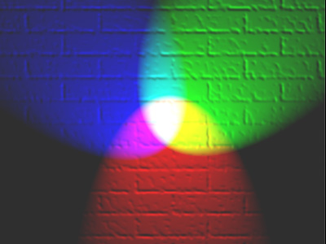
RGB Color mixing
Note that when all the colors are combined, the result is white
Not like paint! (brown or black when combined)
This picture doesn’t show all the possibilities
Doesn’t show gradations of mixing (little red with a lot of blue, etc)
Doesn’t show gradations of intensity within a given shade (light pink vs dark pink, greys between white and black)

Slide 12
Which of these colors is produced by the RGB code 255 255 50?
a)
b)
c)
d)
Hint:
e) None/other/error

Slide 13
About this class
When you use MATLAB later on in scientific applications, you will be working with numbers
If you work with images in this class, will you be prepared to work with that numeric data?
Yes! It’s the same skills, because…
To a computer, everything is numbers.
Why not practice with matrices of numbers, that just happen to be images?

